Slide 1


20+ years of Adaptech Findings
King, L., Jorgensen, M., Fichten, C., Havel, A., Lussier, A., Vo, C., & Harvison, M. (2019, April). 20+ years of Adaptech findings. Presentation at the accessXchange Conference, Montréal, Québec.
Laura King, Mary Jorgensen,
Catherine Fichten, Alice Havel, Alex Lussier,
Christine Vo, Maegan Harvison
accessXchange Conference, Montréal, Québec
April 24-25, 2019
bit.ly/AdaptechResearch
Notes:
Intro, have Adaptech people wave, not Mary
Warm Up with triangles and rectangles:

Slide 2



About the Research
Empirical
Bilingual
International: 5 countries
Methods: qualitative, quantitative, archival
Research grants
  SSHRC
  FRQSC
  MEES
  ECQ

Slide 3

Students with Disabilities
  Self-reported disability: 11%-17% of students¹
  ≈ 2/3 not registered for campus disability services²
  ≈ 50% have multiple disabilities
  Most common disabilities reported
    Learning disability/ADHD
    Mental health conditions
    Chronic health conditions
¹Fichten, C.S., Heiman, T., Havel, A., Jorgensen, M., King, L., Nguyen, M.N., & Budd, J. (2015). Will the real universal design stand up? Postsecondary students with disabilities in Canada and Israel. Manuscript submitted for publication.
²Fichten, C.S., Jorgensen, S., Havel, A., Barile, M., (2006). College students with disabilities: Their future and success. Final report to FQRSC. Montréal: Adaptech Research Network, Dawson College.

Slide 4
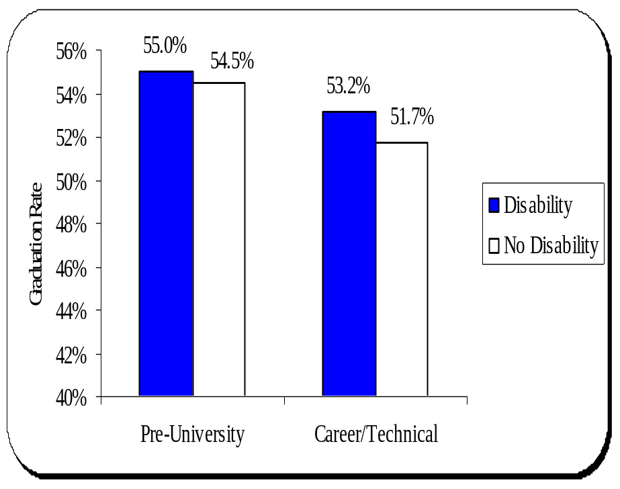
Graduation / Persistence
N = 42,010 college students
Students with/without disabilities graduate at the same rate¹
  Graduation rate
  of students with
  disabilities is higher
    But not significantly
  Take an extra term
¹ Jorgensen, S., Fichten, C.S., Havel, A., Lamb, D., James, C., & Barile, M. (2005). Academic performance of college students with and without disabilities: An archival study. Canadian Journal of Counselling, 39(2), 101-117.

Slide 5
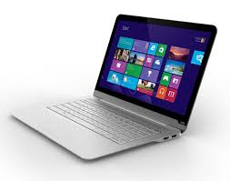
Information & Communication Technologies (ICTs) and Learning Disabilities (LD)
  Widely believed: ICTs help students with LD
    Research is inconclusive
    Our research
          n = 58 experts
          n = 74 students with LD
      Fichten, C. S., Nguyen, M. N., King, L., Barile, M., Havel, A., Mimouni, Z., Chauvin, A., Budd, J., Raymond, O., Juhel, J.-C., & Asuncion, J. (2013). Information and communication technology profiles of college students with learning disabilities. Journal of Education and Learning, 2(1), 176-177.

Slide 6
  ICTs & LD: Our Findings
  Students with LD DON’T use many assistive ICTs recommended by experts
    Expensive
    Steep learning curve
  Students DO use mainstream ICTs as adaptive aids
  Students use smartphones and text messaging as tools
  Insufficient training available on use of ICTs

Slide 7
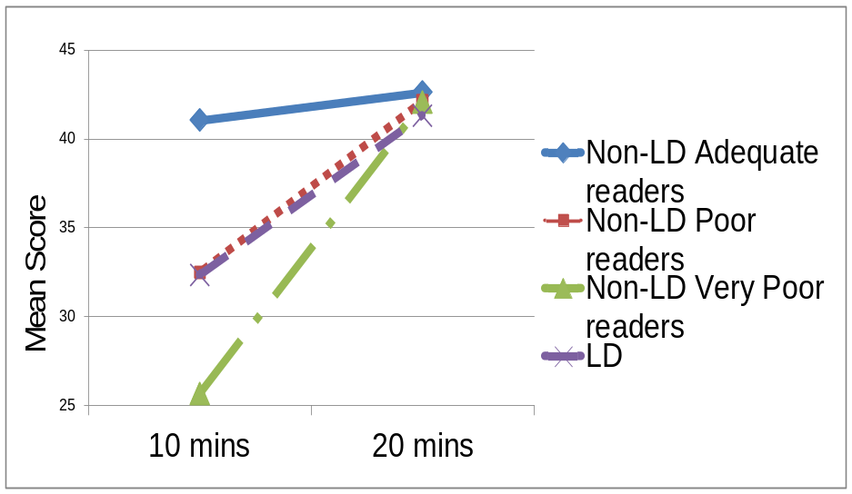
  ICTs & LD: Our Findings
    Study of reading comprehension¹
      432 college students
        Learning disabilities LD
        Poor readers (PR)
        Very poor readers (VPR)
        Adequate readers
      Given adequate time
        Students with LD, PR and VPR have similar comprehension as adequate readers
        Adequate readers’ scores improve only slightly
¹ Fichten, C. S., Nguyen, M. N., King, L., Havel, A., Mimouni, Z., Barile, M., Budd, J., Jorgensen, S., Chauvin, A., & Gutberg, J. (2014). How well do they read? Brief English and French screening tools for college students. International Journal of Special Education, 29(1), 33-46.

Slide 8
Myth and Reality of PowerPoint
331 college students
Students prefer when
  Concepts are written in full sentences
  Images have text descriptions
  PowerPoints are posted online before class
  PowerPoints are posted in PDF and PPT formats
  Slides have good contrast

Slide 9
Personal Technology in Class
4 focus groups, n = 29
In class on-task use of mobile devices
  Facilitate note-taking
  Record lecture
  Take picture of PPT slides or diagrams
Group work in class using Google Docs
Other Google Products
    Search
    Translate

Slide 10



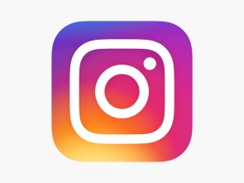
Personal Technology in Class
Off-task use of mobile devices
  Checking social media
  Texting
  Answering e-mails
  Doing homework for other classes

Slide 11
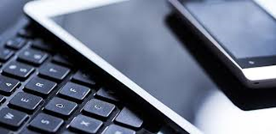
  Adaptech’s Free and Inexpensive Assistive Technology Database
Need for free and inexpensive technologies based on our research
  High cost of adaptive software and hardware
  Lack of information about what is out there
  Inadequate opportunities to try technologies before purchase

Slide 12

Adaptech’s Response
Create a bilingual database to
  Identify
  Test
  Compile free and/or inexpensive technologies
Provide students the opportunity to try different technologies that could help
Ongoing since 1999

Slide 13
Examples
Evernote Touch
HomeWork
NaturalReader Text to Speech
Smart Magnifier
Spell Checker - Spelling boost
SwiftKey Tablet Free

Slide 14
Future Research and Training
    How to integrate smartphones and tablets into teaching
    Listen to student, professional, professor views
    Provide training on
      How to use ICTs
      Universal design UD
      Accessibility
    Explore how free and inexpensive technologies can help

Slide 15

Modeling Accessibility
    Made PowerPoint accessible
    Provided a short Bit.ly Url, USB keys
Provided paper copies
Regular print
Large print
    Used multiple means of presentation

Slide 16


Thank you, questions?

Slide 17
  For More Information
  Laura King
  laura.king@claurendeau.qc.ca
  Adaptech Research Network
  http://www.adaptech.org/
  Download this presentation at
  bit.ly/AdaptechResearch

