Slide 1




Academic Impact of the Covid-19 Pandemic on Post-Secondary Students with and Without Disabilities
Catherine Fichten, Jennison Asuncion, Mary Jorgensen, Alice Havel, Olivia Ruffolo, Rosie Arcuri, Maegan Harvison, Francesco Salvo, Christine Vo, Susie Wileman
Adaptech Research Network
Accessing Higher Ground Conference, November, 2021

Slide 2
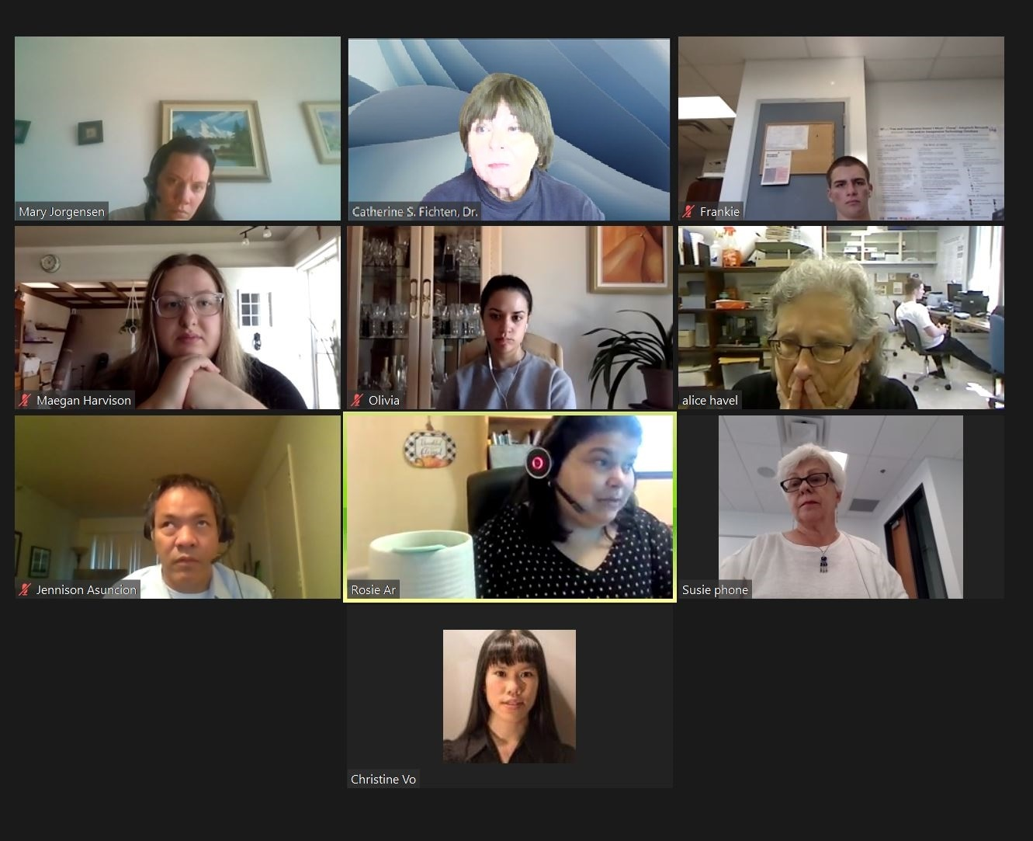
Adaptech Research Network Team

Slide 3

Goals
Find out about the impact of Covid-19 on academic lives
  Post-secondary students with & without disabilities
    During remote learning
    Back to face-to-face learning in fall 2021
  Post-secondary campus access service professionals
  Post-secondary faculty
Based on
      Survey on 172 students during remote learning period
      Testimonials by students, faculty and campus professionals

Slide 4
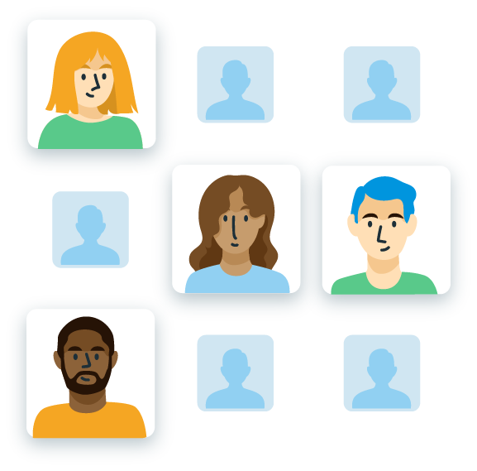
Methodology of Survey on Students
Participants
  55 attended university, 112 a junior/community college
  121 students with disabilities
    75 females, 39 males, 7 non-binary gender
  51 students without disabilities
    32 females, 18 males, 1 did not indicate

Slide 5
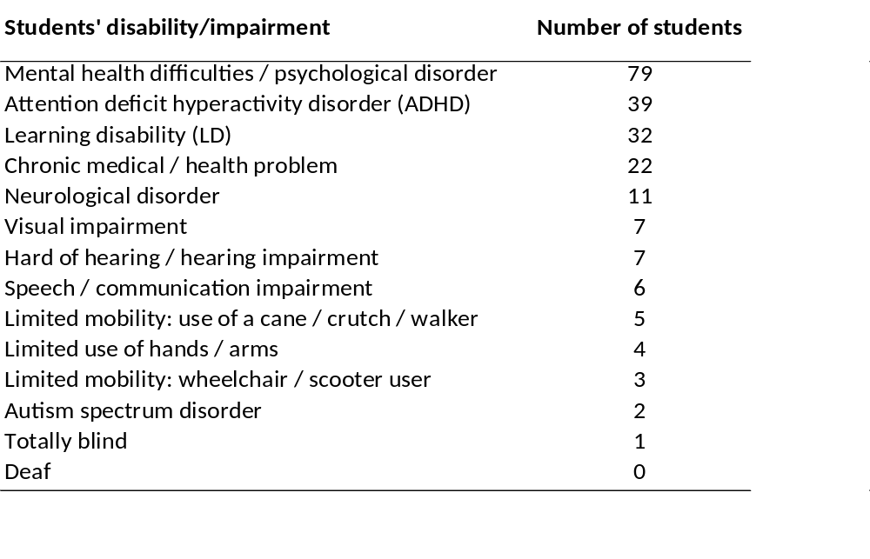
Self-Reported Disabilities / Impairments
The 121 students indicated 218 different disabilities
50% of students had multiple disabilities / impairments

Slide 6

Survey Questions
Accessible LimeSurvey administered in fall 2020
  Questions
    What is the impact of the pandemic on your grades?
    What is the impact of the pandemic on your academic life?

Slide 7
Survey Results: Impact on Academic Performance
What is the impact of the pandemic on academic performance?
Group | Grades: no change | Grades: improved | Grades: deteriorated | Dropped courses
Students with disabilities | 36% | 26% | 38% | 8%
Students without disabilities | 54% | 23% | 23% | 0%

Slide 8
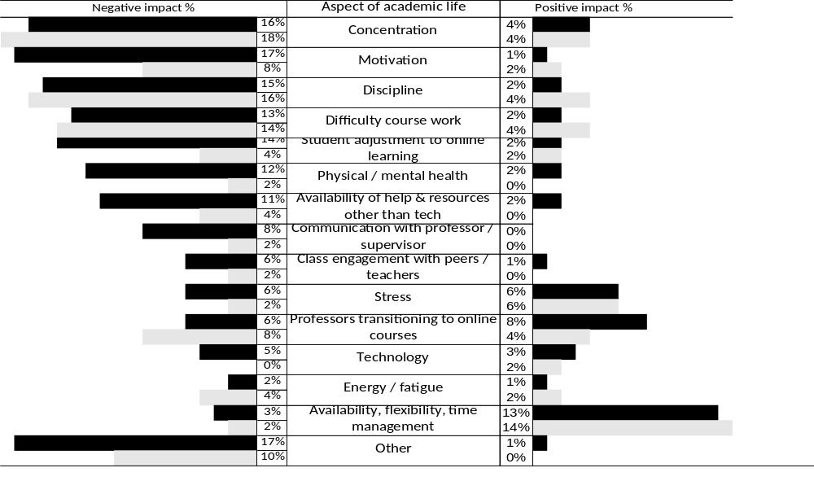
Results Impact on Academic Life
  Legend: Black bars refer to students with disabilities. Light gray bars refer to students without disabilities

Slide 9

Giving People a Voice!
Research does not tell the whole story
What is the lived pandemic experience
  Students
  Campus access service providers
  Faculty
  Quotes will start to describe their experiences
  Session participants will share their experiences

Slide 10

Survey Participant Testimonials (1)
Research participants – remote learning
I found it harder to concentrate because I couldn't go elsewhere to study due to the restrictions.
It was easier for me to procrastinate when watching or going to a virtual class than a class in-person.

Slide 11
Survey Participant Testimonials (2)
Research participants – remote learning
I was very overwhelmed.
It was harder to get answers to questions from teachers.

Slide 12
Survey Participant Testimonials (3)
Research participants – remote learning
I had more time to focus on my studies and work because I had less commute time (saving 3 hours).
I had more time to work on my own schedule.

Slide 13

Adaptech Research Network
Student Testimonials During Remote Learning (1)
Cat, a university student – remote learning
Recorded synchronous classes have helped the transition to remote learning because they have given me the flexibility to watch at my own pace while also following a regular semester pace of presented material.
Increased screen time has lead to increased fatigue, which has impacted my sleep schedule.

Slide 14
Adaptech Research Network
Student Testimonials During Remote Learning (2)
Maegan, a university student – remote learning
It’s been hard to learn from home. Quite anxiety-inducing for me. Having my bedroom be the same place I learn as well as getting countless notifications about my courses every day has made it hard to tease apart my personal time and class time. I find myself worrying about school when I should be having time for myself.
It was a very quick transition from using technologies I was comfortable with to suddenly having to use multiple different software or applications for different courses.

Slide 15
Adaptech Research Network
Student Testimonials During Remote Learning (3)
Christine, a college student – remote learning
COVID-19 has stressed me out a lot by making it
extremely difficult for me to properly follow along with online courses.
Laboratories for science-related courses are much more difficult since I do not have all of the materials required, or no time to go get them due to medical reasons.

Slide 16
Adaptech Research Network
Student Testimonials During Remote Learning (4)
Rosie, a mature university student – remote learning
After working for nearly a decade,
As a legally blind student, taking classes online meant I was able to use my technology to better: follow class content, access class materials and interact with classmates.
School online is an absolute game changer and I’m now hoping to complete a Masters online.
online courses were the perfect way to get back to school… from the comfort of home! The idea of taking classes again after so long was less stressful and I was able to focus on the content rather than spending time and energy getting to being on campus.

Slide 17
Adaptech Research Network
Student Testimonials During Remote Learning (5)
Olivia, social work student – remote learning
Teaching assistants were able to provide extra help and constructive feedback on assignments and ensured that all questions were answered.
Having to do both school and work remotely made for a very lonely year; zoom was very impersonal and made it difficult to create new or substantial relationships.

Slide 18
Adaptech Research Network
Student Testimonials During Remote Learning (6)
Francesco, a college student – remote learning
A big problem I have with remote learning is being able to stay concentrated. After sitting in the same seat and looking at the same screen for many hours a day my mind starts to drift off. There are also household distractions.
COVID-19 and remote learning resulted in me spending a lot more time on screens. As a result, I ended my days with eye discomfort and with my eyes full of tears.

Slide 19

Adaptech Research Network
Student Testimonials During in Person Learning (1)
Cat, a university student - in person learning
I wish my school had returned to fully in person instead of this in between state of some classes being online and some in person. It is exhausting to rush between school and home to alternate between in-person and online classes.
I feel out of practice for studying for non-open book exams now that some of my classes are back to being in person or have proctored online exams.

Slide 20
Adaptech Research Network
Student Testimonials During in Person Learning (2)
Olivia, a university student - in person learning
Being back in school feels good. It gives me somewhere to go every day and allows me to feel like an actual student again.
I would love to still be able to choose whether I go in or not. Hybrid would’ve been best.

Slide 21
Adaptech Research Network
Student Testimonials During in Person Learning (3)
Francesco, a college student - in person learning
In person classes have really improved my mental health. I find myself enjoying going to school, opposed to how unhappy I was, attending school online.
In person classes have made me more stressed. This is the result of having to take two hours out of each of my days traveling and having less time to do schoolwork.

Slide 22

Testimonials: Campus Access Service Provider
Alice, a disability service provider – “then” and “now”
“Then.” As students were usually at home, sometimes I could hear parents coaching in the background. I got in the habit of initially asking who was attending the meeting.
“Now.” Computers for tests/exams were not viewed as accommodations when classes were online. Now, students who need to use tech must once again request it as an accommodation. This presents a good argument for UDL.

Slide 23

Testimonials: Faculty in 2020 (1)
Stephanie, a university professor – “then” and “now”
Then: If it weren’t for the pandemic and the necessity to have to teach online, I don’t think I would have learned all these new skills on my own!
Now: We were very fortunate to have outstanding training and support from the University as well. This made it all possible for me.

Slide 24
Testimonials: Faculty in 2020 (2)
Rajesh, a college professor – “then” and “now”
Then: I did not enjoy the experience of remote teaching as conversation with students was not always spontaneous and thus interaction was limited. On-line work was necessary. Moodle and Zoom are highly accessible to screen readers.
Now: I am very glad to be back teaching in person and am pleased to answer many more questions students ask when face-to-face.

Slide 25
Testimonials: Faculty in 2020 (3)
Robert, a university professor – “then” and “now”
Now that we are back in class, we still have this "bow in our quiver", and we want to use it. Our students want us to use it. In my case, several live lectures are now recorded, so students can "speed it up" "slow it down" or "review over and over.”
Then: The pandemic forced profs to use unfamiliar but powerful platforms. It became very clear very quickly that these platforms allowed for greater flexibility in terms of delivery.

Slide 26
Testimonials: Faculty in 2020 (4)
Davina, a college professor – “then” and “now”
Then: I had to completely overhaul my course and learn new technology when school tech support was lacking. Juggling with childcare and elderly parents was stressful. A true mixture of burnout and excitement, depending on the day. A roller coaster year!
Now: At first scared to be in small classrooms with 40 breathing students. Got over fear quickly. Teaching with masks challenging. Projecting my voice. Glasses fogging. Which students are speaking?
But very happy to see students again.

Slide 27
Testimonials: Faculty in 2020 (5)
Kelly, a college professor – “then” and “now”
Then: We learned numerous new technologies and platforms, but it was lonely - for both students and teachers
Now: Teaching face-to-face again was like "coming home." Students (and teachers) were freshly energized. At this point in the semester, it feels as though the students are disillusioned with the reality of being back on campus and they are struggling more so than usual with motivation and productivity (they got used to the "online/covid way").

Slide 28

Conclusions and Discussion
What have your experiences been during remote and newly in person learning?
How can understanding the impact of COVID-19 on students inform necessary institutional change?
How can research about the impact of
COVID-19 inform sustainable practice?
How can understanding the impact of
COVID-19 on students inform future faculty training?

Slide 29

Thank You!
Adaptech Research Network: www.adaptech.org Catherine Fichten: catherine.fichten@mcgill.ca

