Slide 1

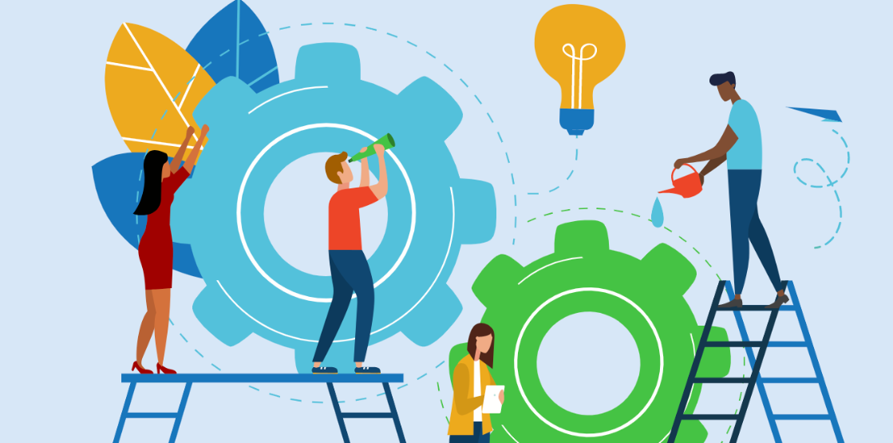


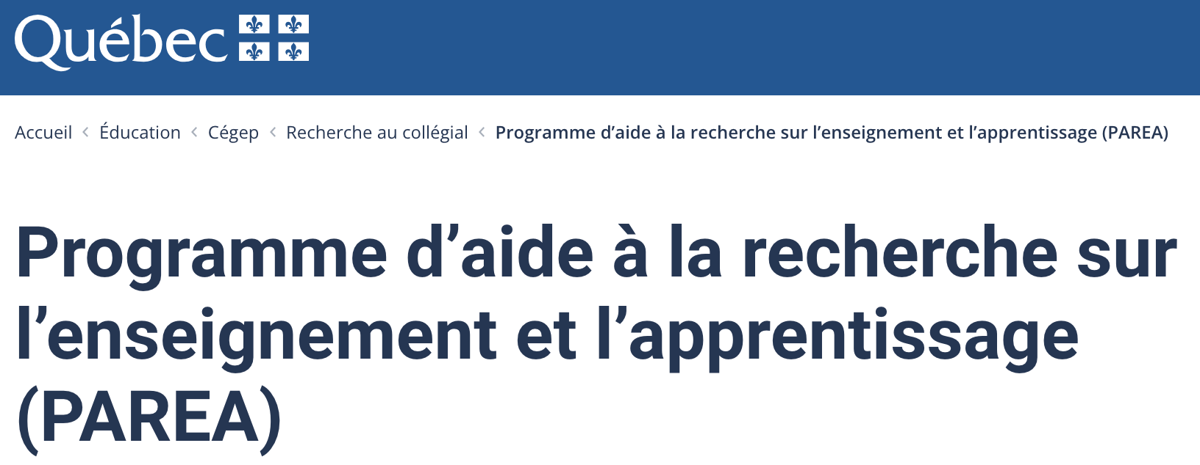
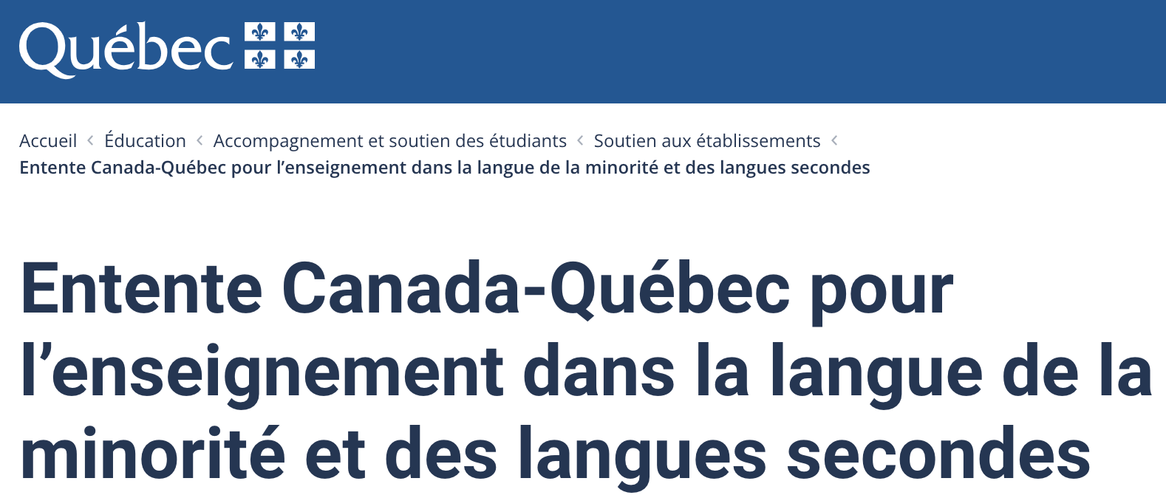


Can engaging in funded research be a form of professional development?
Dawson College
Pedagogical Day
Oct 13, 2023
Liz Charles
Anna-Liisa Aunio
Catherine Fichten
Kevin Lenton
Mathilde Hitier
Notes:
Their team is particularly interested in thinking about new pedagogies for Brazilian middle schoolers and teenagers. They are very interested in ways teachers can adopt new approaches in the classroom, such as active learning pedagogies, and how we should train/socialize such teachers into these approaches. We thought you could share in more depth your experience with Saltise: what it is, how you manage to build and maintain it, and what are the main results and learnings so far. What are the main lessons learned through your experience with Saltise regarding teacher training and technology-rich learning experiences? Also, how would you see something like Saltise working in a country far beyond the Global North?

Slide 2
Objectives
to introduce the topic of research at the college level
to list the various agencies that fund college researchers
to describe several of our projects with a focus on the following:
  preparing the grant,
  building a team - if necessary,
  balancing responsibilities of teaching and conducting research
to discuss how our research contributes to changing our teaching practices positively – i.e., professional development
to ask what questions participants have4
1
2
3
4
5
Notes:
Description (70 word max)
Many college teachers are interested in understanding processes of teaching and learning but lack time or opportunity. What if such pursuits were characterized as pedagogical research and considered professional development? [insert number of teams] of college researchers will describe their experiences obtaining grants and running research projects that positively impacts their teaching practices – building knowledge, resources and communities along the way. This workshop provides insights into how to start and where to find resources.
Objectives: At the end of the session, participants will be able to:
Identify types of projects that make for successfully funded college-level research; which funding sources are more available to college-level researchers. Participants will also be introduced to the mechanics of the grant application processes including: preparing the grant, building a team, balancing responsibilities of teaching and conducting research. Lastly, they will engage in discussion as to ways research contributes to changing teaching practices – i.e., professional development.

Slide 3
Who are we? What types of research do we do?
Introducing ourselves

Slide 4
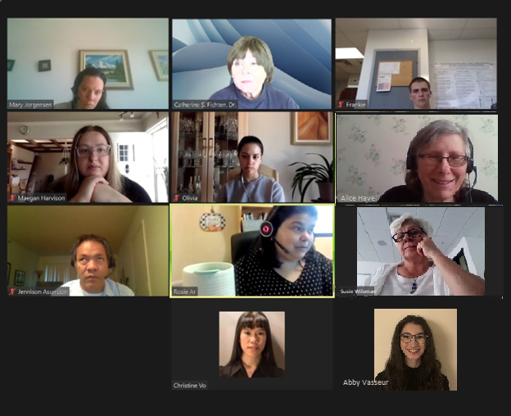
Catherine’s research & her colleagues

Slide 5
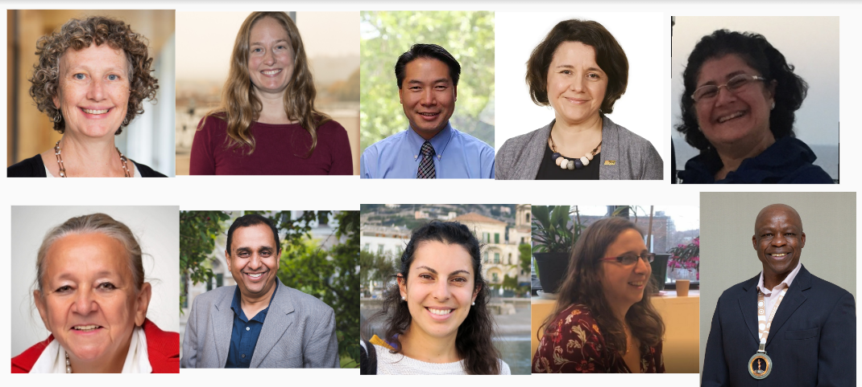










Anna-Liisa’s research & her colleagues

Slide 6
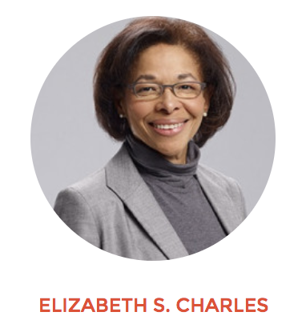
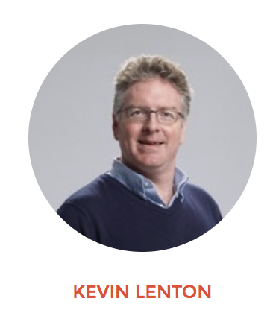
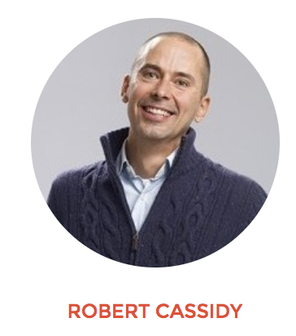
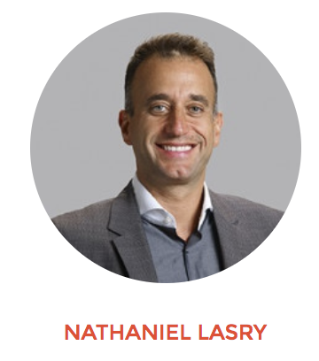
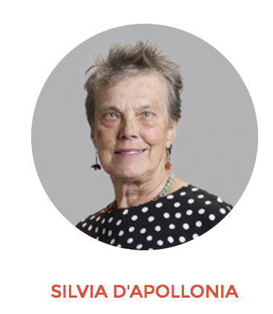
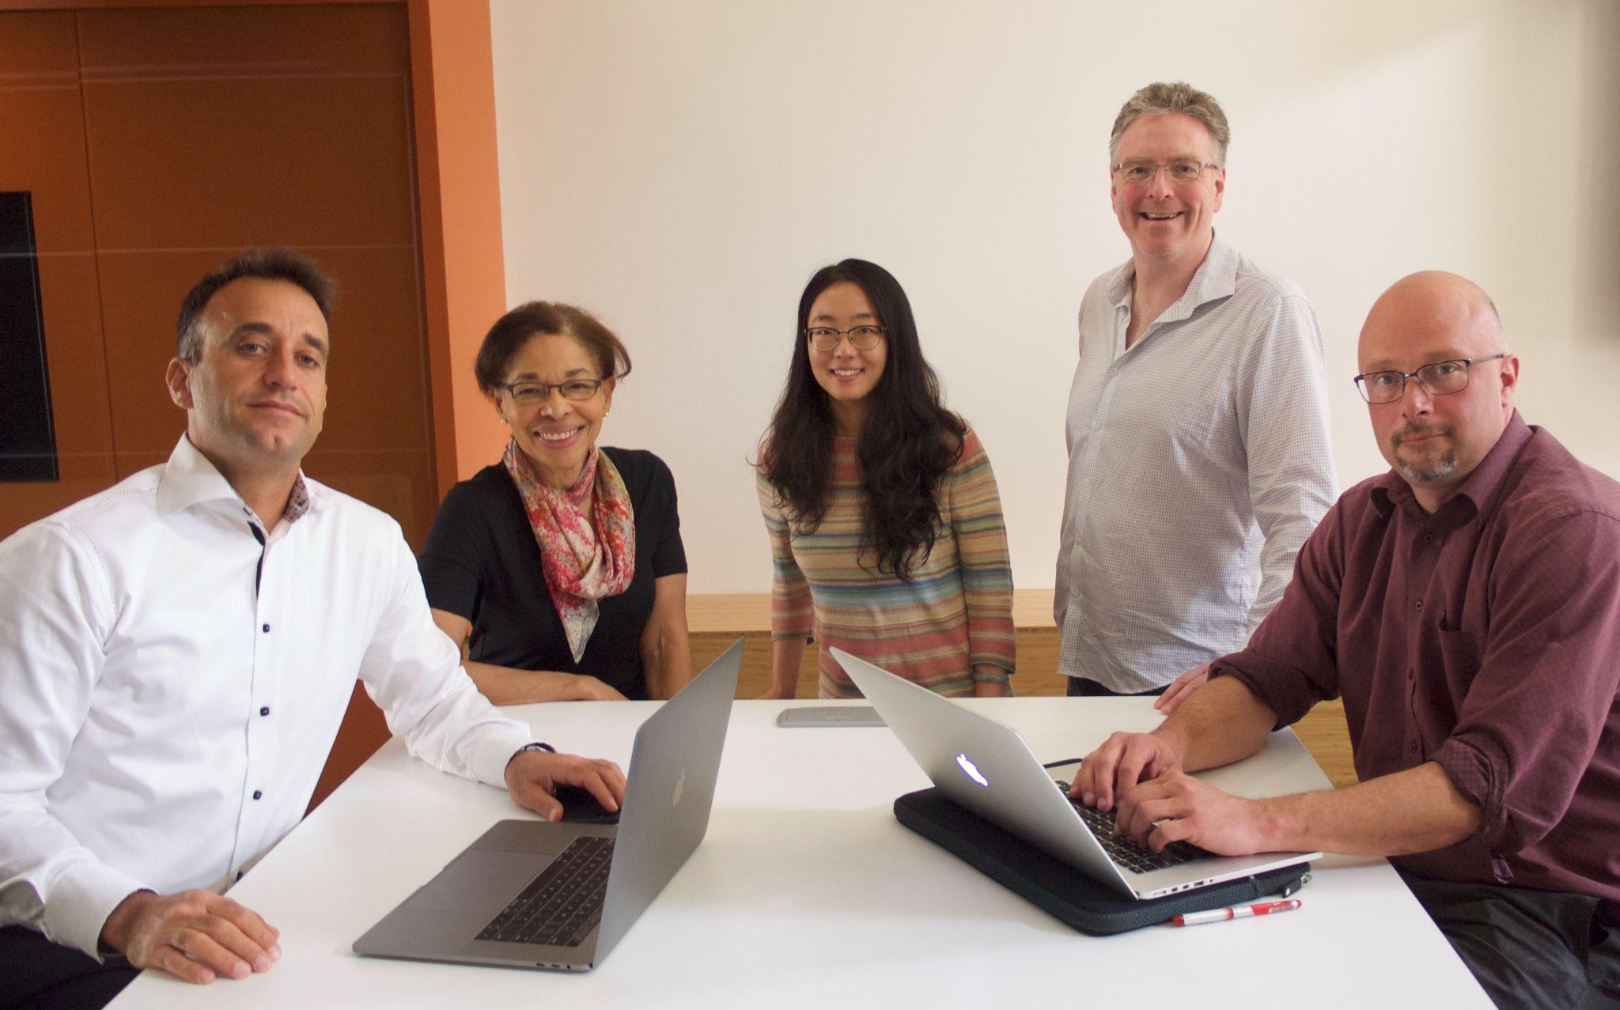
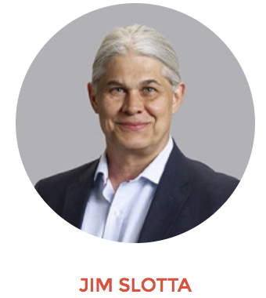
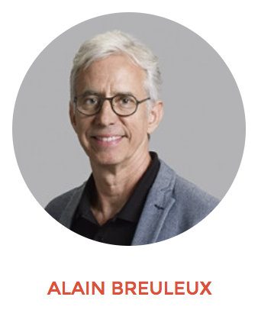
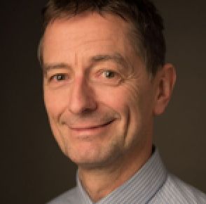
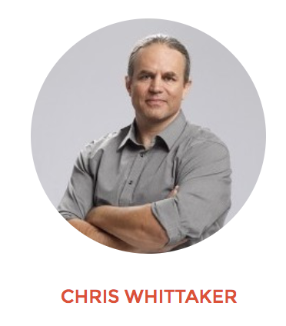
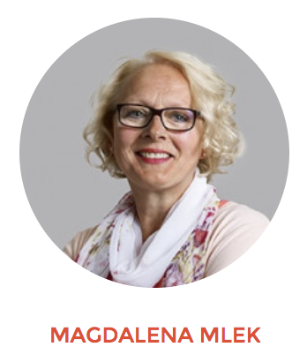
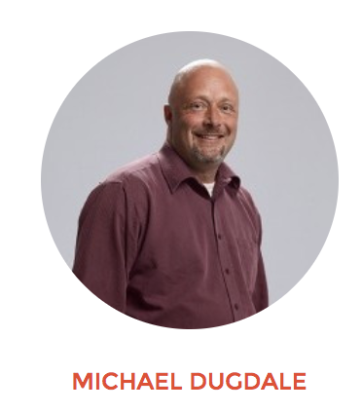
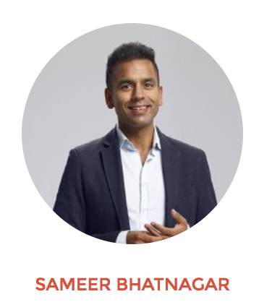
Our SALTISE Team:
Over the years
Collaborators &
Graduate Students
BRUNO POELLHUBER
Notes:
Saltise photos

Slide 7
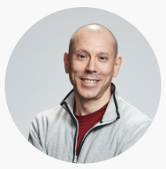
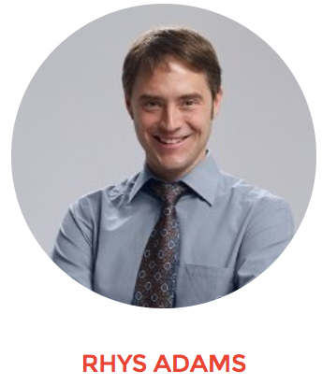
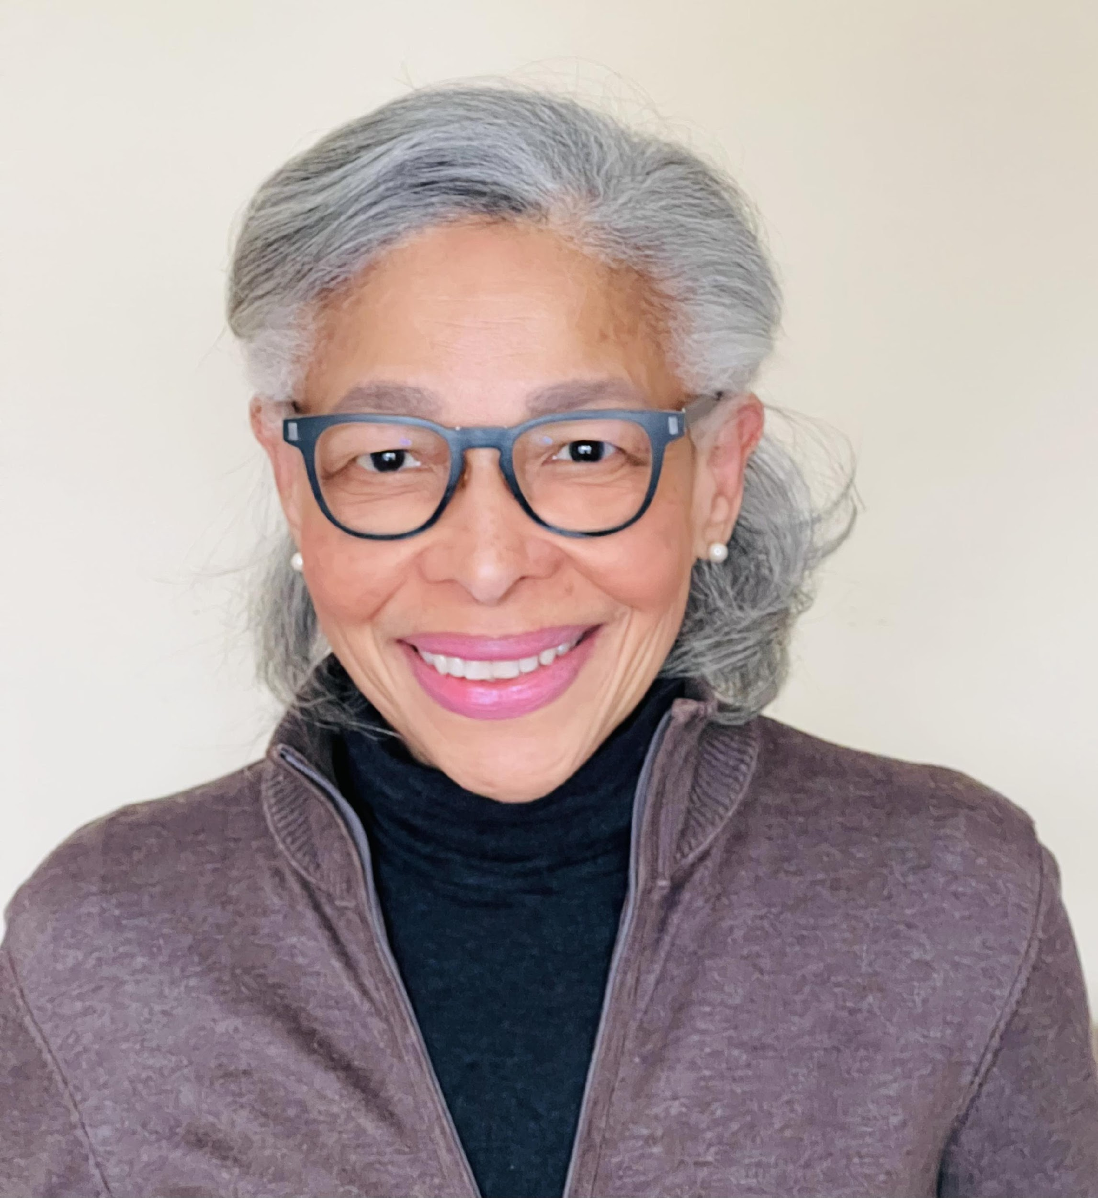
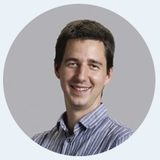
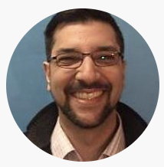
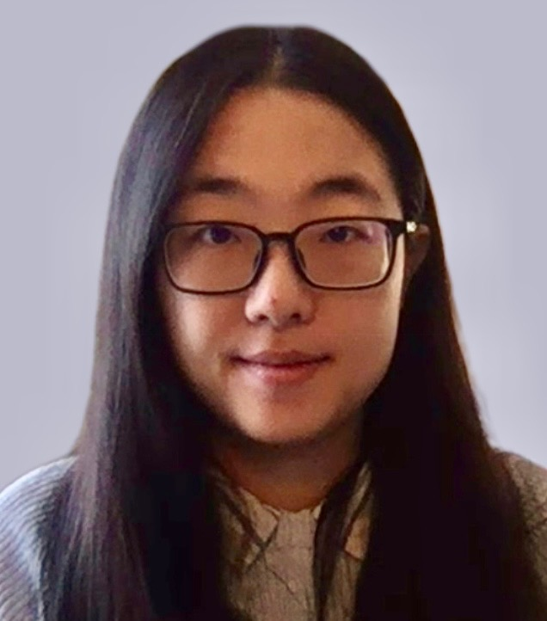




PAREA research team
Vanier College
Dawson College
KARL LAROCHE
MATHILDE HITIER
ANNE-HELENE SAMSON
JEAN-FRANCOIS
BRIERE
John Abbott College
McGill University
SEAN HUGHES
CHAO ZHANG

Slide 8
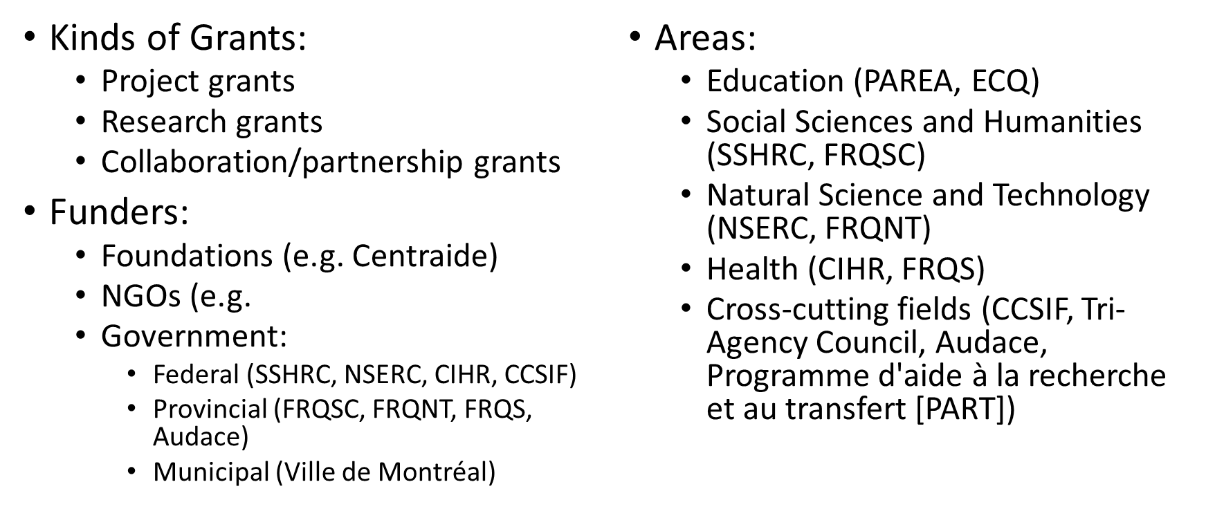
Overview of Funding Opportunities

Slide 9
Our projects and what skills are involved
writing the grant
building a team - some grants allow individual applications
preparing & uploading applications
  navigating funding agency portals
  dealing with curriculum vitae requirements
applying for ethics certification – REB
  TCPS: CORE 2022
balancing responsibilities
  teaching and conducting research
  evenings, weekends, summer & other holidays

Slide 10
Research as professional development
Implications of actively engaging in doing research:
modeling the process that are being taught
providing opportunities for students to get involved in research
contributing to college’s recruitment
contributing to your discipline’s knowledge base
avoiding burnout

Slide 11
Questions from participants
??????
????

Slide 12
Thank You!!!
Dawson College
Pedagogical Day
Oct 13, 2023
Please feel free to contact us directly for follow up.
Liz Charles
Anna-Liisa Aunio
Catherine Fichten
Kevin Lenton
Mathilde Hitier
Notes:
Their team is particularly interested in thinking about new pedagogies for Brazilian middle schoolers and teenagers. They are very interested in ways teachers can adopt new approaches in the classroom, such as active learning pedagogies, and how we should train/socialize such teachers into these approaches. We thought you could share in more depth your experience with Saltise: what it is, how you manage to build and maintain it, and what are the main results and learnings so far. What are the main lessons learned through your experience with Saltise regarding teacher training and technology-rich learning experiences? Also, how would you see something like Saltise working in a country far beyond the Global North?

