Slide 1






Difficulty Initiating or Maintaining Sleep and Insomnia in PAP Adherent and Non-Adherent Individuals with OSA:
A Prevalence Study
Catherine Fichten^{1,2,3} , Eva Libman^{1,2} Dorrie Rizzo^{1,5}, Sally Bailes^{1,2}, Laura Creti^{1,2}
¹Jewish General Hospital, ²McGill University, ³Dawson College, ⁵Université de Montréal
Montreal, Canada

Slide 2

Objective: To Answer These Questions
  Are there gender differences in PAP adherence and non-adherence?
  How does self-reported PAP adherence compare with objective PAP machine chip data?
  What is the frequency (prevalence) of Difficulty Initiating or Maintaining Sleep (DIMS) and Insomnia Disorder (as compared with the more typically reported severity) in individuals with OSA?
  Is adherence and non-adherence to PAP treatment associated with insomnia-related disorder?

Slide 3

Methods
Participants
  80 older primary care patients with OSA, recommended PAP therapy
    Tested at time of OSA diagnosis
    24 subsequently PAP adherent by self-report (16 F, 8 M)
    56 subsequently PAP non-adherent by self-report (31 F, 25 M)
    21 participants with chip adherence data
Measures
    Sleep Questionnaire (single items measure)
    Interview
    PAP machine adherence data
Procedure
  Participants evaluated at time of OSA diagnosis

Slide 4

Methods (cont’d)
Definitions
  Adherence: using PAP device =>4 hours, 70% of nights, 90 days
  DIMS: undesired wakefulness =>3x/wk., min.= 3 months
    Sleep onset latency (SOL) : >30 min. undesired wakefulness
    Sleep maintenance difficulty (WASO): > 30 min. undesired middle of the night wakefulness
    Terminal DIMS: wakefulness & inability to return to sleep > 30 min. earlier than desired
  Insomnia Disorder: DIMS + complaint of insomnia

Slide 5

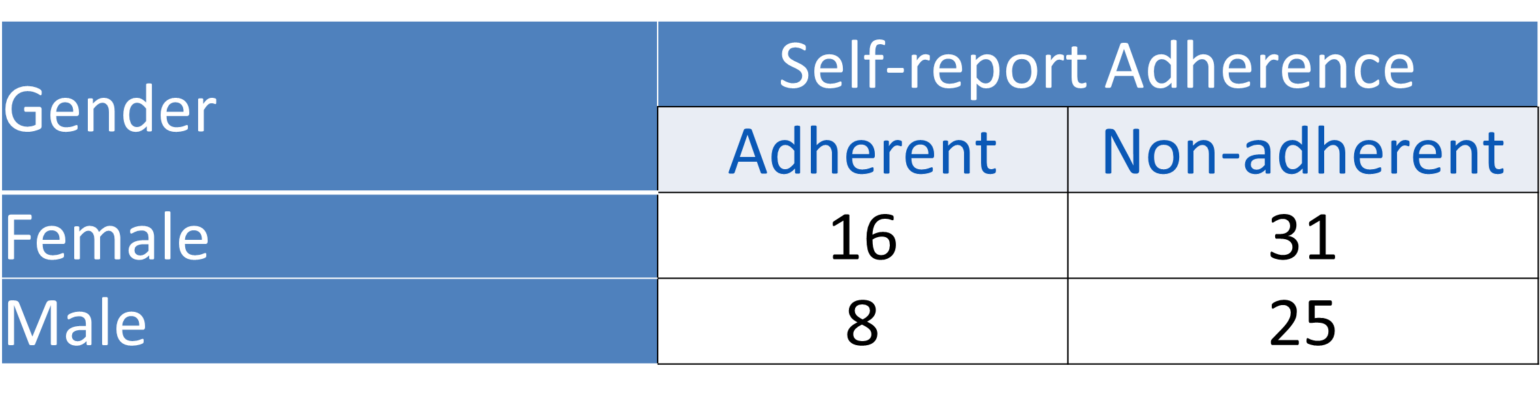
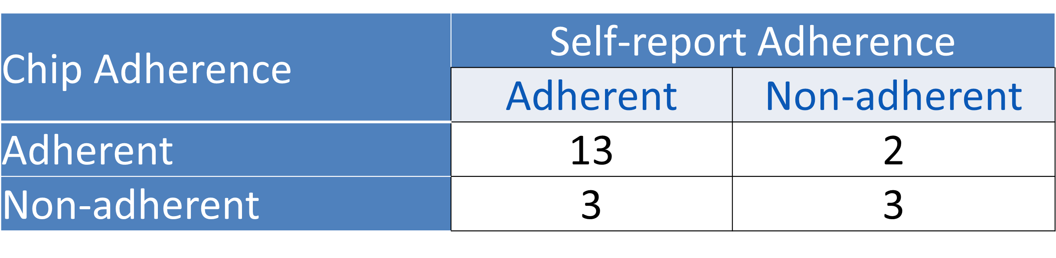
Results
Question 1: Gender
  X²: no sig. adherence difference
  between males & females
Question 2: Chip and self-report
adherence relationship
  X²: on self-report and chip
  adherence not significant
  Pearson correlations: self-reported
  and chip-based nocturnal PAP
  hours were significantly correlated,
  r(21) = .724, p<.001

Slide 6
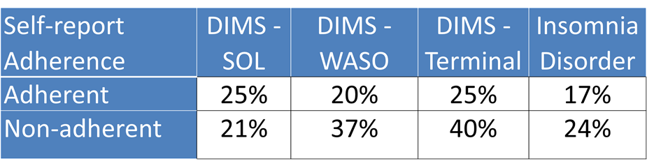

Results (Cont’d)
Questions 3 and 4: DIMS and insomnia related to adherent
and non-adherent status
  Percentage of SOL DIMS was similar
  for adherent and non-adherent
  WASO and Terminal DIMS were higher
  among non-adherent than adherent
  48% of adherent, 50% of non-adherent
  participants had similar rates of
  “mixed insomnia” (i.e., DIMS with no
  insomnia complaint, insomnia
  complaint with no DIMS)

Slide 7

Conclusions
The literature typically shows more severe insomnia in PAP adherent than non-adherent individuals
  Contrary to such results, we found
    No substantial difference in insomnia between the two groups, and
    More frequent WASO and Terminal DIMS in the non-adherent group
  This may be due to a discrepancy between severity and frequency scores
No gender difference on adherence to PAP therapy
  Suggests that adherence data from males and females may be combined
Self-reported hours of PAP machine use were highly correlated with objective PAP machine chip data
  Suggests that self-reported PAP use data are reliable
For more information contact: Catherine.fichten@mcgill.ca

