Slide 1



How Has Covid-19 Affected Mobile Tech Use by Students with Disabilities?
Mary Jorgensen, Susie Wileman, Catherine Fichten, and Alice Havel
Adaptech Research Network
Accessing Higher Ground Conference,
November 18, 2021

Slide 2

Goals
Conducted two studies to
  Ask what mobile tech post-secondary students used
  Ask what tech professors requested that students use
  Explore smartphone / tech use during the pandemic
  Discuss problems students encountered
Notes:
Need to explain that is is two studies from the same data.
The 2nd one is a subset (n =24) of the first, larger group.

Slide 3
Pandemic-Related Tech Challenges
Sudden transition to remote learning
  Professors new to teaching online
  Problems with
    Videoconferencing platforms
    Course management systems
  Students did not sign-up for remote learning
  Students encountered unexpected difficulties using tech
Notes:
There were many! We wanted to find out

Slide 4
Study 1: LimeSurvey Methodology
Participants n = 172 current students
  55 university, 112 junior/community college
  121 students with disabilities
    75 females, 39 males, 7 non-binary gender
  51 students without disabilities
    32 females, 18 males, 1 did not indicate

Slide 5
Study 1: Research Question # 1
  Technologies used to do schoolwork
    What technologies worked well
      For students with disabilities
      For students without disabilities
Technology used | No disability - worked well | Disability - worked well
Zoom | 64% | 66%
Google Docs | 100% | 96%
Microsoft Word | 100% | 79%
Omnivox (Quebec university/college portal) | 100% | 82%
Calendar (excluding Google Calendar) | 100% | 93%
Microsoft Teams | 100% | 50%
Google Drive | 100% | 100%

Slide 6
Study 1: Research Question # 1 (Cont’d)
What technologies did not work well
    For students with disabilities
    For students without disabilities
Technology | No disability - worked poorly | Disability - worked poorly
Zoom | 36% | 34%
Google Docs | 0% | 4%
Microsoft Word | 0% | 21%
Omnivox (Quebec university/college portal) | 0% | 18%
Calendar (excluding Google Calendar) | 0% | 7%
Microsoft Teams | 0% | 50%
Google Drive | 0% | 0%

Slide 7
Study 1: Research Question 2
What smartphone or tablet did you use to do schoolwork?
Smartphones used by
  68% of students with disabilities
  61% of students without disabilities
Tablet used by 27% of students with and without disabilities
Technology | Students with disabilities | Students without disabilities
Smartphone - iPhone | 40% | 46%
Smartphone - Android | 28% | 15%
Tablet - iPad | 19% | 24%
Tablet - Android | 6% | 1%
Tablet -Other | 2% | 1%

Slide 8

Study 1: Conclusions
2/3 students used some form of mobile tech for schoolwork
Difficulties students encountered
      Uploading assignments
      Keeping track of due dates
      Problems with technologies
Students with disabilities encountered more difficulties

Slide 9

Study 1: Implications
Why did students with disabilities encounter more difficulties
  Accessibility issues?
  Lack of support from professors?
  Other possible reasons?

Slide 10
Study 2: Methodology
Participants
  24 students (15 2-year college, 9 university)
    15 females, 8 males, 1 Genderqueer
  Responses to 4 emailed questions
    Tech professors asked students to use during COVID-19
    Difficulties encountered in use of tech

Slide 11
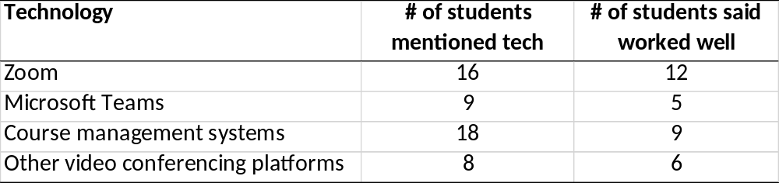
Study 2: Technologies Profs Asked
Students to Use
There were also 30 technologies that 1 or 2 students said teachers asked them to use

Slide 12
Study 2: Apps Mentioned by a Few Students
Kahoot!
Discord
Google Drive
Discipline specific apps
  Dr. Java
  PuTTY
  Brackets
  Cisco Packet Tracer

Slide 13
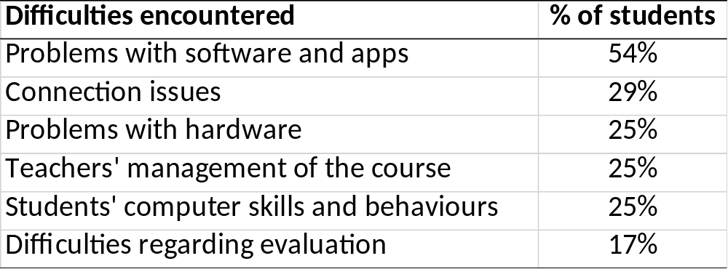
Study 2: Difficulties Encountered

Slide 14
Study 2: Implications
Students need to be taught how to
  Use breakout rooms in Zoom
  Upload assignments
    File formats and sizes that students can submit
Professors need to check the chat in Zoom
Rules for student behavior during online classes required
Students find recording lectures helpful
Notes:
Supporting students with the online submission of assignments: Inform students about what type of documents and size of file can be uploaded as an attachment for submission.

Slide 15
Study 2: Strategies to Show Students How to Use Technology
YouTube videos
PowerPoint
Word document
Live demonstration in class
Pre-recorded tutorial on course management system

Slide 16
Take Home Message: The Importance of Diversity
All students had some difficulty adapting to remote learning
Important to take into account environmental factors that disadvantage students
The need to learn how to use new technology is common among all students

Slide 17

Study 2: Questions to Consider
Who is responsible for ensuring that students have updated versions of software?
What are the best ways to show students how to use technology?
Which of the technologies used during the pandemic are likely to be helpful during in-person classes?

Slide 18

Thank You!
Adaptech Research Network: www.adaptech.org
Mary Jorgensen: mjorgensen@dawsoncollege.qc.ca

