Slide 1
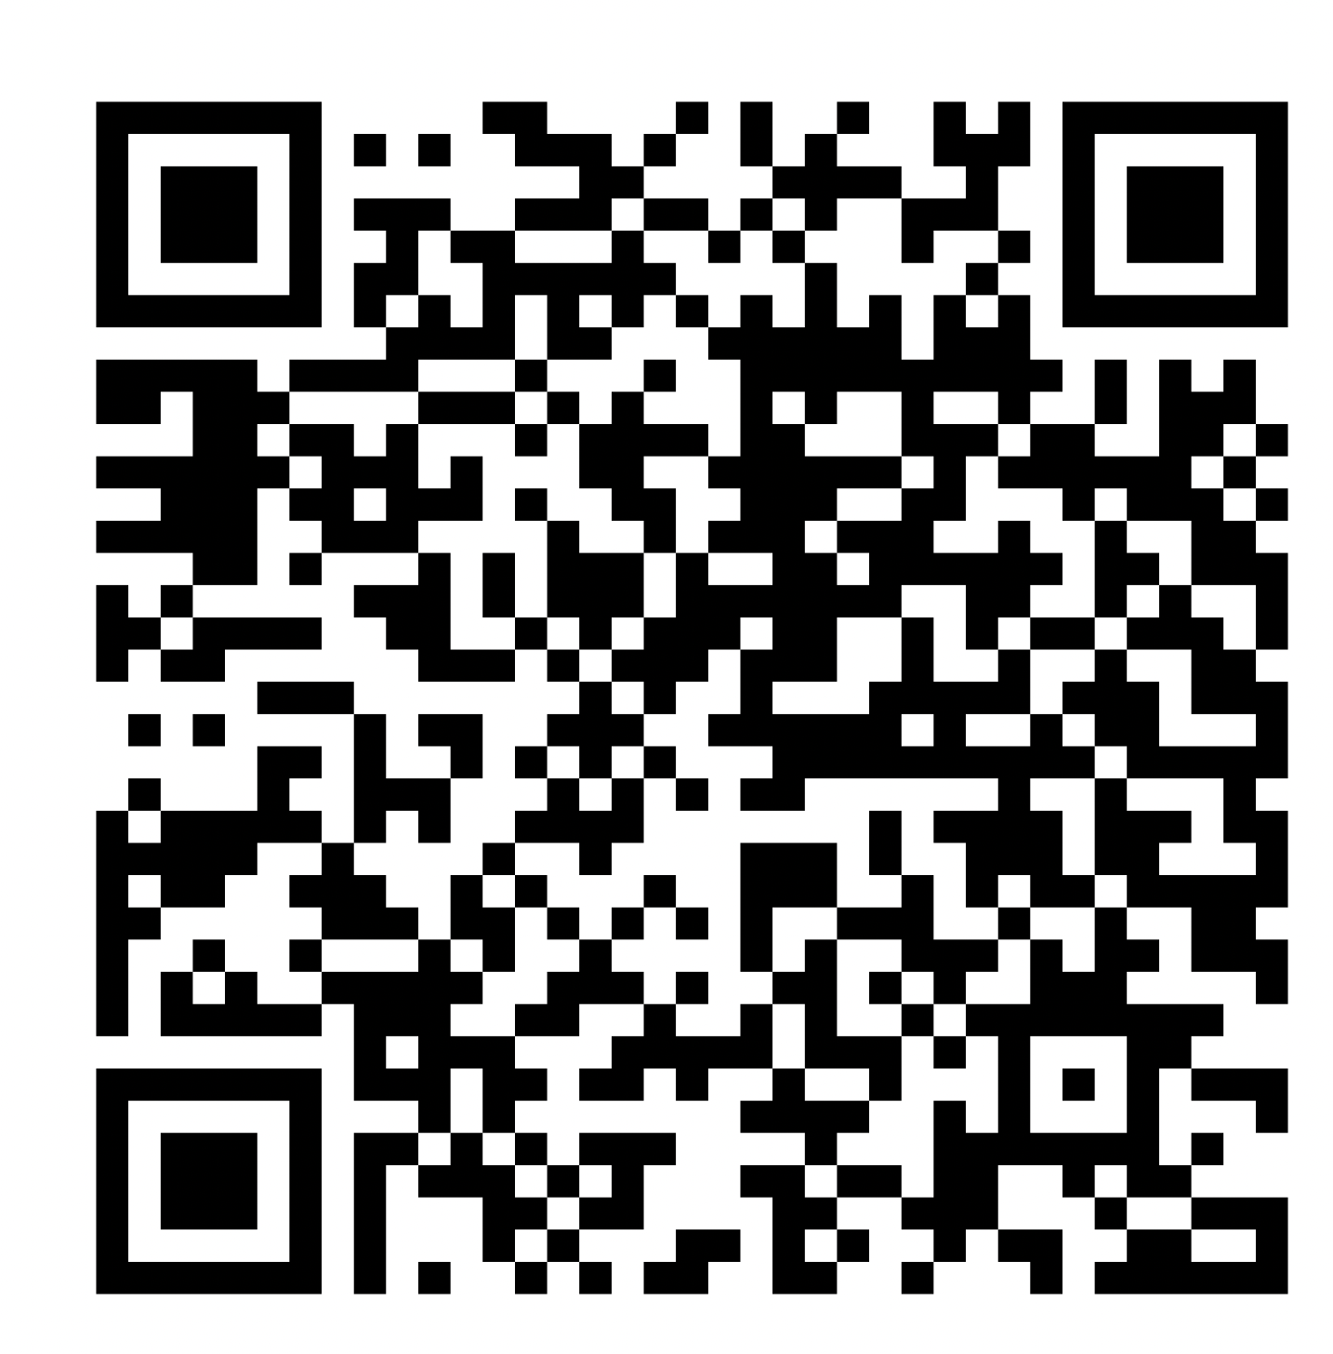
Digital Copy of Our Presentation
https://shorturl.at/fjoxZ

Slide 2



Influential Trends:
Information for Faculty Concerning Technologies for Students with Disabilities
Giso Iravani-Manesh, Alice Havel,
Catherine Fichten, & Christine Vo
Adaptech Research Network
SALTISE, Montreal
June 13th, 2023
https://shorturl.at/fjoxZ

Slide 3

Who Are We?
The Adaptech Research Network:
  Team: teachers, access counsellors, students, researchers
  Research: on post-secondary students with & without disabilities
  Focus: on technologies
  Based at: Dawson College
https://shorturl.at/fjoxZ

Slide 4

Word Documents
Fonts: Times New Roman
Font size: 12 - 14 points
Font colors: good contrast with background
Headings: 20% bigger - use Styles
Backgrounds: single color
https://shorturl.at/fjoxZ

Slide 5

PowerPoints
Fonts: use a sans serif font, such as Arial or Calibri
Title: use 40 point font
Body: use 36, 32, 30, 28 point font
  Minimum 24 point font
Background
  Avoid distracting background images
  Use high contrast between text & background
https://shorturl.at/fjoxZ
Notes:
https://www.pcmag.com/reviews/microsoft-powerpoint-2016

Slide 6
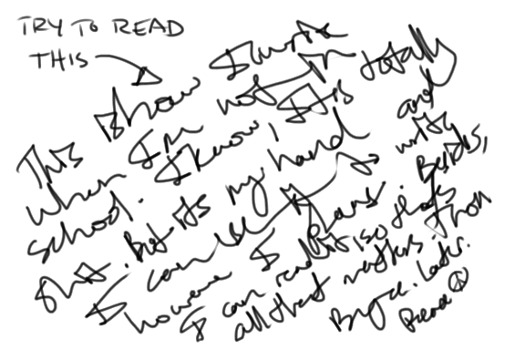
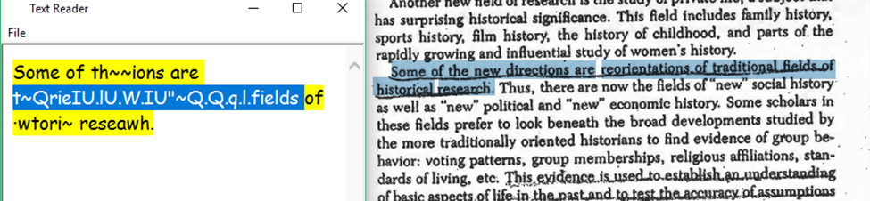
Course Packs: AVOID!
Italics & underlining (bold is best)
Missing or light text
Handwriting
Content cut off at edges
Partial pages visible on side
https://shorturl.at/fjoxZ

Slide 7

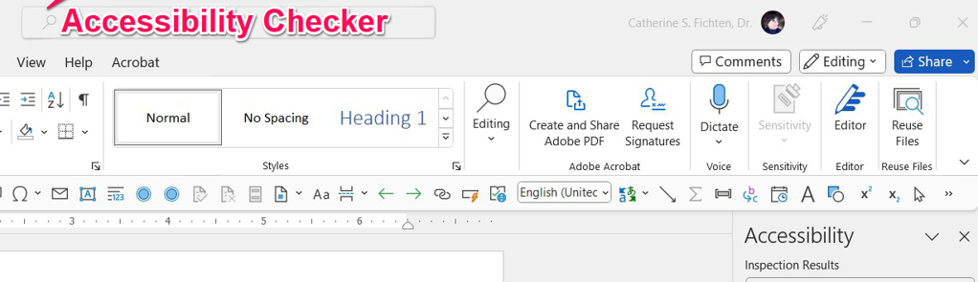
Make Sure Formats Are Accessible
Digital accessible
Format is important for access to screen readers, etc.
  Microsoft → Tools → Check Accessibility
    OR type ‘Accessibility Checker’ into the Help bar on top
https://shorturl.at/fjoxZ

Slide 8
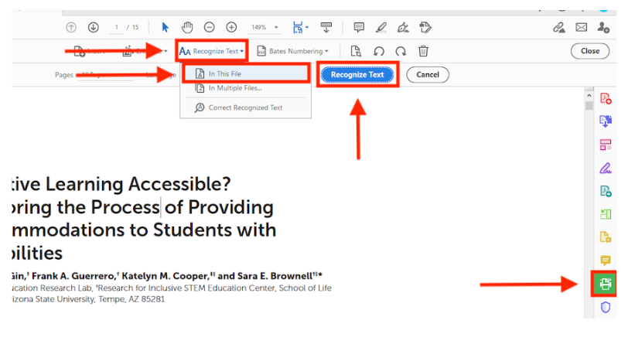
OCR PDF Documents
Adobe Acrobat Pro DC: Tools → Scan & OCR → Recognize Text → In This File → Recognize Text → Save
https://shorturl.at/fjoxZ

Slide 9
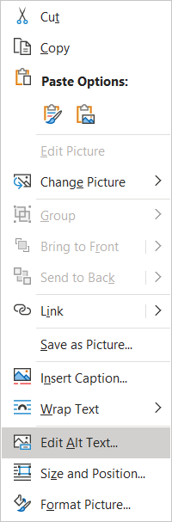
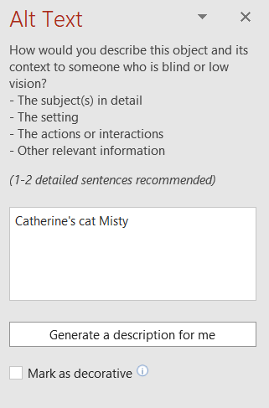
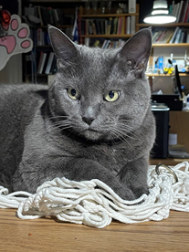
Alt Text – Microsoft
Windows: Right-hand click on image → Edit/View Alt Text
https://shorturl.at/fjoxZ

Slide 10
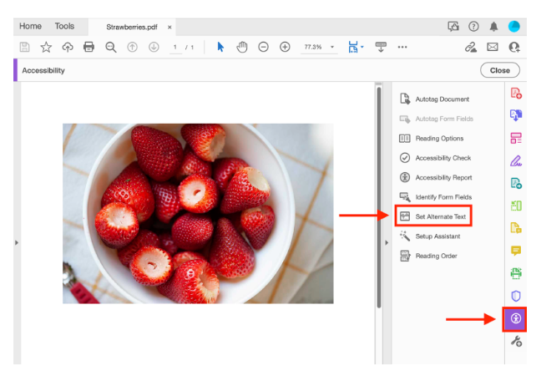
Alt Text - PDF
(More) Tools → Accessibility → Set Alternate Text
https://shorturl.at/fjoxZ

Slide 11
Accessible Tables
Avoid tables – Excel is not always accessible!
  Add alt text to tables or graphs
  Label all cells in columns
  Number all rows
Row 1 | Name | Phone number | Email
Row 2 | Jane Doe | 555-123-4567 | Jane.Doe@gmail.com
Row 3 | John Smith | 555-456-7123 | John.Smith@outlook.com
https://shorturl.at/fjoxZ

Slide 12
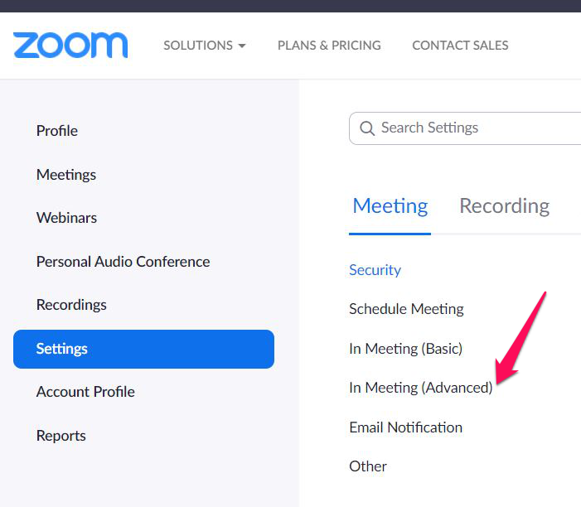
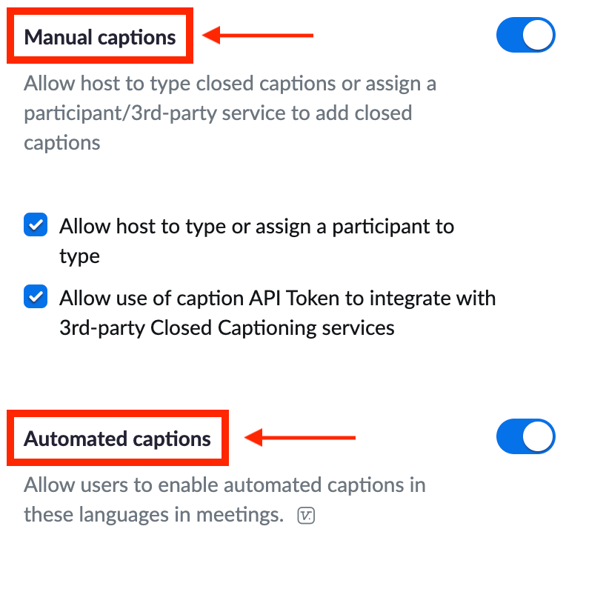
Zoom Captions
Log into your Zoom account (zoom.us) → Settings → In Meeting (Advanced) → Manual captions OR automated captions
https://shorturl.at/fjoxZ

Slide 13
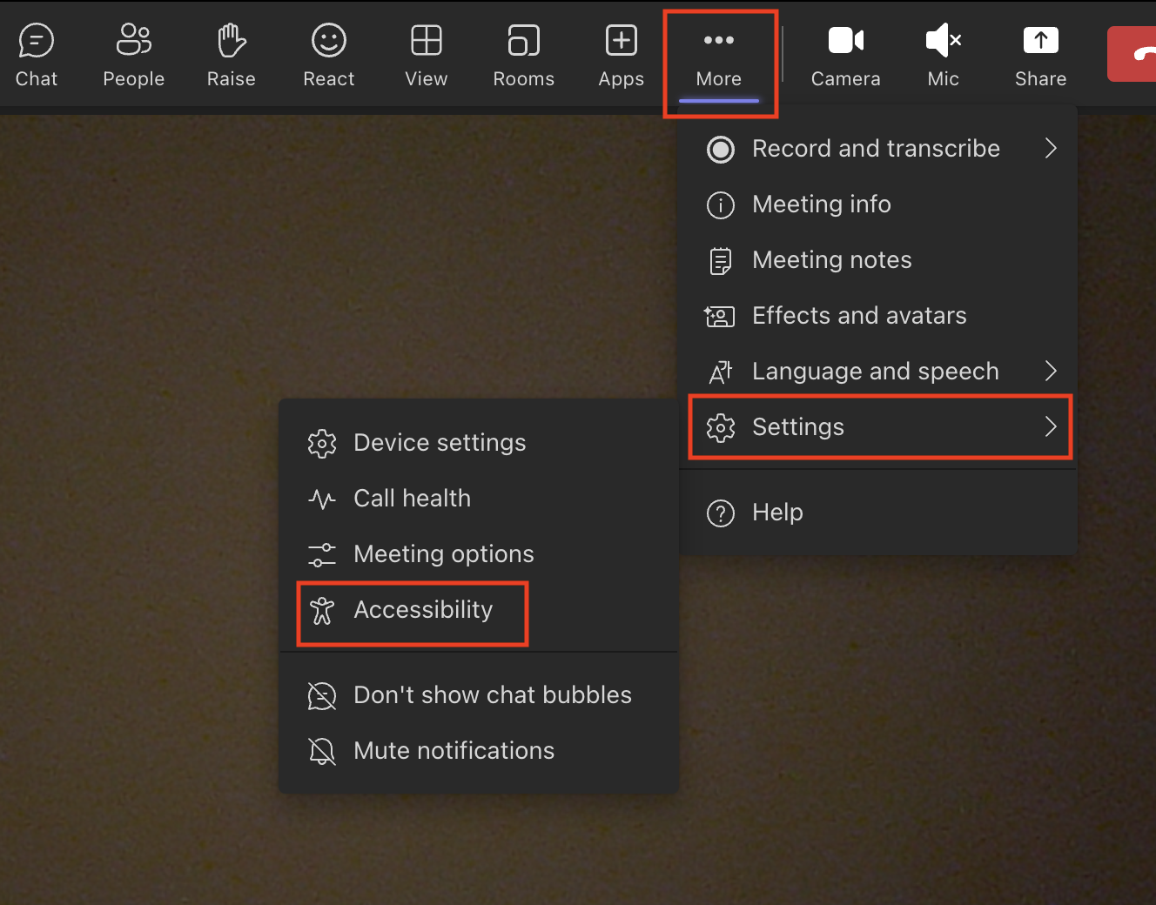
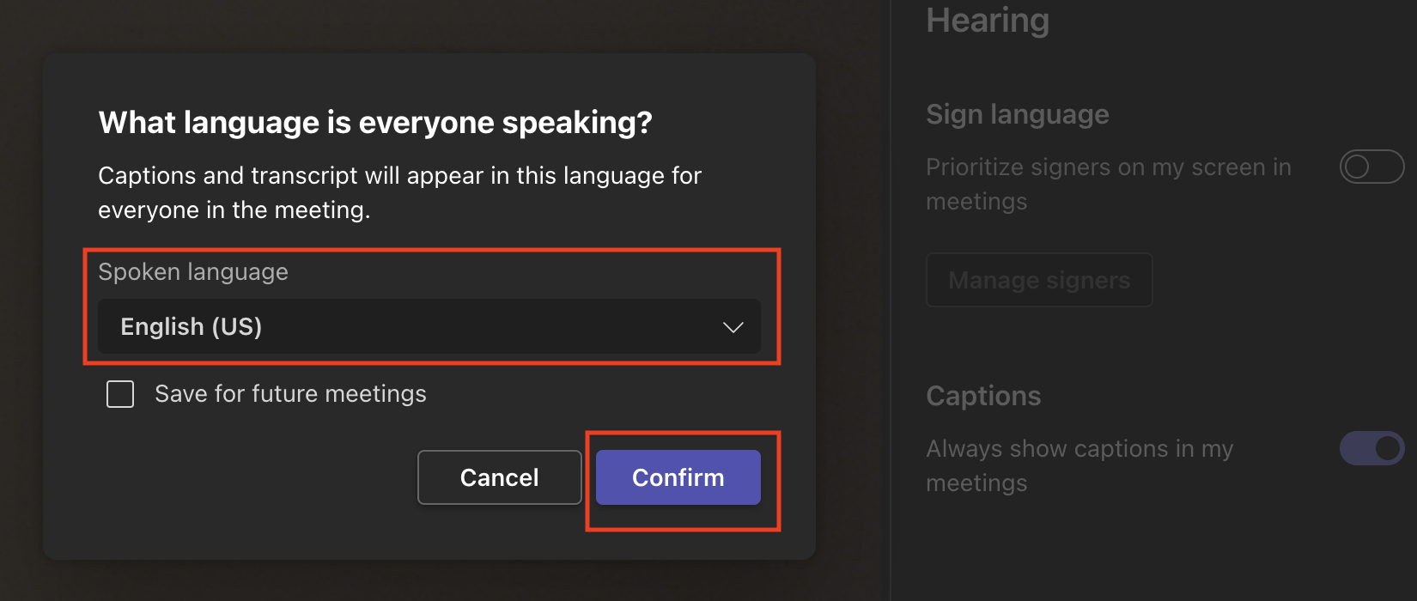
TEAMS Captions
Start your TEAMS meeting → More → Settings → Accessibility → Captions → choose language → Confirm
https://shorturl.at/fjoxZ

Slide 14

Resources
MOOC: Basics of Inclusive Design for Online Education https://www.coursera.org/learn/inclusive-design
Adaptech Research Network
www.adaptech.org
Giso Iravani-Manesh: giravanimanesh@dawsoncollege.qc.ca
Alice Havel: ahavel@dawsoncollege.qc.ca
Catherine Fichten: catherine.fichten@mcgill.ca

Slide 15
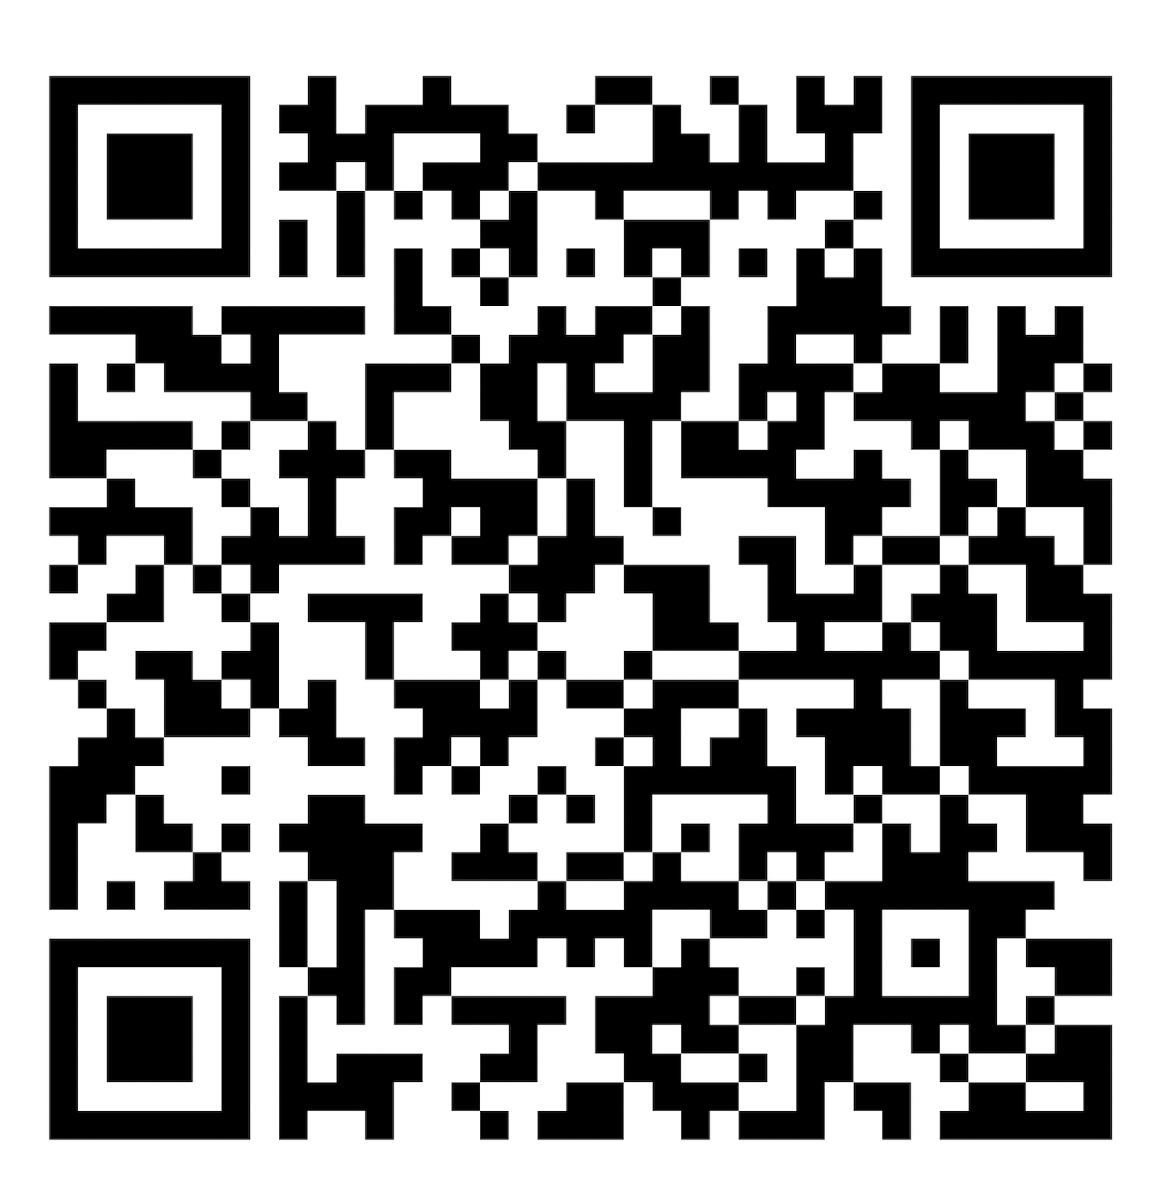
Full Presentation
shorturl.at/abeS4

