Slide 1



Influential Trends Related to Emerging Technologies and Digital Accessibility for
Post-Secondary Students with Disabilities
Catherine Fichten and Members of the
Adaptech Research Network
National Dialogues and Action for Inclusive Higher Education and Communities
December 2, 2022

Slide 2

Who Are We?
The Adaptech Research Network
  Team: faculty, students, researchers, service providers
  Research on post-secondary students with & without disabilities
  Focus on technologies
  Based at Dawson College
Goals today
  Reflect on tech changes in the past decade

Slide 3
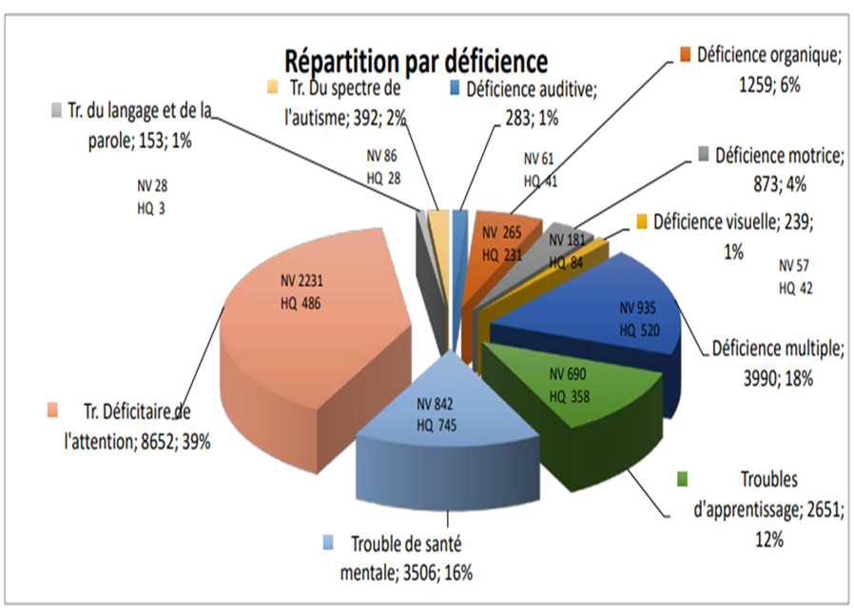
Who are the Students with Disabilities in 2022?
  Self-reported disability: 11%-25% of students
  Students with “non-visible” disabilities
      Attention deficit hyperactivity disorder 39%
      Mental health related disabilities 16%
      Learning disabilities 12%
  ≈ 2/3 not registered with campus access services

Slide 4
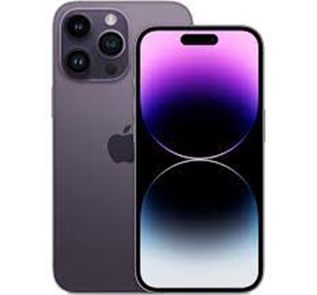
Impact & Evolution of the Accessibility of General Use Technologies
Built-in accessibility features
  Harness potential of general use tech as AT for all students
  Office 365
  Adobe Acrobat Pro
  Proliferation of audiobooks, EPUB
  Mobile technologies
Notes:
Office 365
Accessibility checker/corrector, immersive reader, magnification
Adobe Acrobat Pro
OCR, keyboard alternative to a mouse, high contrast

Slide 5
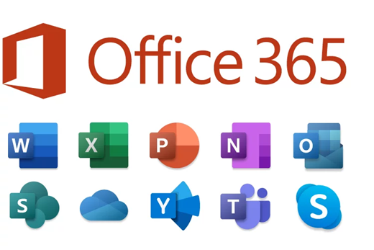

Increasing Use of Artificial Intelligence (AI) in General Use Technologies
Video captioning (craptions): Zoom, TEAMS
Office 365
Voice search for search engines
Control of computer using voice commands (e.g., Siri)
Google Lens part of Google search on smartphone
AI based psychological support apps
Notes:
Office 365
Text-to-speech, dictation, word prediction

Slide 6

Continuing Barriers
Data analysis software, peer reviewed journal databases
Certain content difficult to access through audio
Some AT software & hardware are still expensive
Design of academic evaluations can create barriers
Inaccessible documents & coursepacks produced by faculty
French language software often not up-to-date
Notes:
Digital ≠ accessible
Data analysis software, peer reviewed journal databases
Incompatible with students’ AT
Problems for STEM

Slide 7

Interesting Emerging Tech
Virtual and augmented reality, the metaverse
Telecollaboration
  Remote access to real-world field trips etc.
Smart glasses
Smart gloves
Indoor navigation
Potential of robots in STEM
Notes:
Virtual and augmented reality, the metaverse
Development of chemistry labs
Smart glasses
Cameras, headphones, & heads-up, text, sign language displays

Slide 8


In Summary
  Many beneficial tech related changes
  Many barriers remain
  The future is exciting!
Adaptech Research Network: www.adaptech.org
Catherine Fichten: catherine.fichten@mcgill.ca

