Slide 1






Let Research Help You Navigate the Waters of Technology in the Classroom
Mary Jorgensen, Laura King, Catherine Fichten, Alex Lussier and Alice Havel
Webinar for the Association pour les applications pédagogiques de
l'ordinateur au postsecondaire (APOP)
May 18, 2018
Notes:
CF

Slide 2
Team
Rhonda Amsel : Université McGill
Tiiu Poldma : Université de Montréal
Jennison Asuncion : Réseau de recherche Adaptech
Robert Cassidy : Université Concordia
Alexandre Chauvin : Réseau de recherche Adaptech
Andrée Dagenais : Centre de documentation collégiale
Tali Heiman : Open University of Israel
Maureen Hewlett : Mount Royal College
Shirley Jorgensen : Collège Dawson
Isabelle Laplante : Centre de documentation collégiale
Catherine Loiselle : CRISPESH
Notes:
CF

Slide 3
Team
Catherine Loiselle : CRISPESH
Ryan Moon : Cégep @ Distance
Mai Nhu Nguyen : Réseau de recherche Adaptech
Nicole Perreault : REPTIC
Odette Raymond : Réseau de recherche Adaptech
Louise Ross : Cégep André-Laurendeau
Rafael Scapin : Collège Dawson
James Sparks : Collège Champlain
Susie Wileman : Collège Dawson
Christine Vo : Collège Dawson
Notes:
CF

Slide 4

Agenda
Why we conducted this research
Our research
  Phase 1: Student perspective
  Phase 2: Teacher perspective
  Phase 3: Comparison of the two perspectives
Innovative technology used by teachers
Do’s and don’ts of research
Notes:
LK

Slide 5

Why Did We Conduct this Research
To disseminate results
To have an impact on pedagogy
To encourage collaborative effort
To highlight the perspectives of different stakeholders
To solve problems related to technology
Notes:
LK

Slide 6
Phase One: Student Perspective
Notes:
LK

Slide 7
Phase One: Research Overview
Students from 1 English, 1 French language Cegep
  Paper questionnaire in 56 compulsory classes
  Recruitment of students for the online questionnaire
Questionnaire
Notes:
LK 311 students from 1 English and 1 French language Cegep were surveyed
Students completed a paper questionnaire in one of their general education courses and 311 were contacted again to answer a different questionnaire online.
The students who answered the second questionnaire are the ones who agreed to be contacted for future research and who were at least in their second term at Cegep.
Part of the questionnaire was a technology checklist that was put together based on feedback from technology experts in the Cegep system

Slide 8
Method
Online questionnaire
  Experiences with technology in Cegep
    Checklist of technology used by teachers
      How well does it work
    Open-ended questions
    Nominate up to 3 teachers who used technology well
Notes:
LK

Slide 9
Student Characteristics
Sample size = 311
Gender
    Female: 59%
    Male: 40%
Age: average = 20.50
Program of study
    Pre-university: 69%
    Technical / career: 30%
Notes:
LK

Slide 10
I Like Courses Where
Professors Use Technology
Notes:
MJ

Slide 11
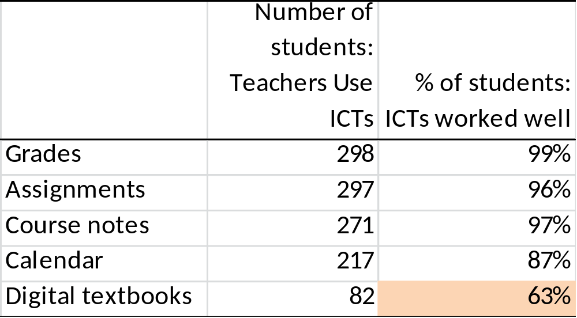
Course Materials Available Online
Notes:
MJ

Slide 12
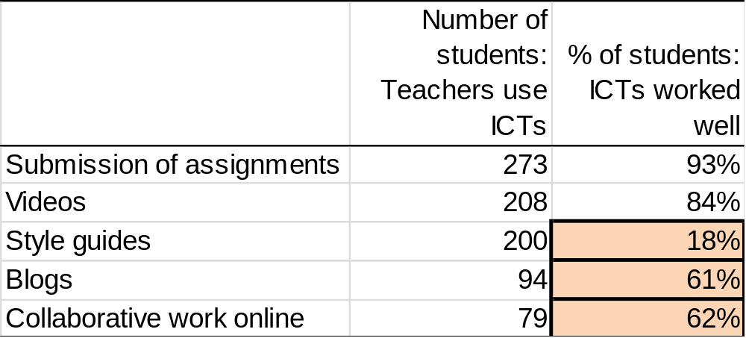
Online Tools used by my Teachers
Notes:
MJ

Slide 13
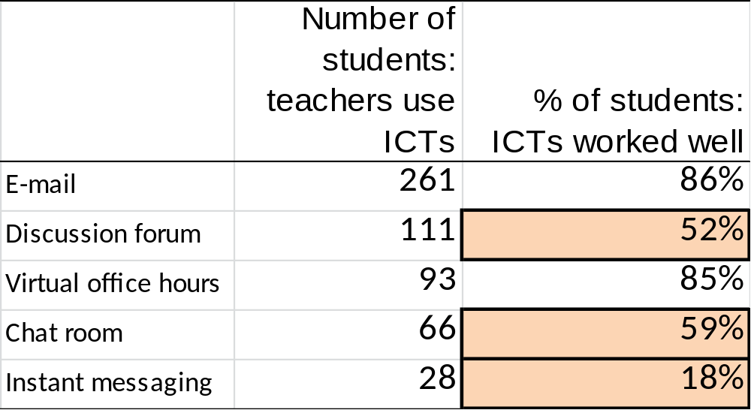
Communication Tools used by my Teachers
Notes:
MJ

Slide 14

What Did and Did Not Work Well According to Students
PowerPoint
  Worked well
    Helps with note-taking
    Facilitates understanding of material
    Helps maintain interest
  Worked poorly
    Covering slides too quickly
    Vague content
    Too much text on slides
Notes:
MJ

Slide 15

What Did and Did Not Work Well According to Students
Videos
  Worked well
    Short Videos
    Helps explain material
    Facilitates understand the material
  Worked poorly
    Long videos
    Old videos
    Poor quality videos
Notes:
MJ

Slide 16

What Did and Did Not Work Well According to Students
Course/learning management system
  Worked well
    Posting grades online quickly
    Posting the class average online
    Posting assignments online quickly
  Worked poorly
    The use of many different CMS/LMS
    Web links to videos not posted online
    Calendar not up-to-date
Notes:
MJ

Slide 17
Student Views: Use of Personal Technology in Class
Notes:
MJ Résultats concernant l’utilisation de leur propre tech = important pour les politiques pcq certains département, voire des cégeps entiers, ont des règles très strictes concernant l’utilisation de la tech personnelle en classe. Do we want to talk about Smart Boards and whether or not our research validated the project (the one putting them in schools)?

Slide 18
Students’ Suggestions
Install more wall plugs in the classrooms and throughout the Cegep
Make software more accessible to students
Never forget that technology does not replace the teacher
Make sure the teacher is proficient with technology before using it in class
Avoid reading the PowerPoint slides
Notes:
MJ

Slide 19
Phase Two: Teacher Perspective
Notes:
LK

Slide 20
Phase Two: Research Overview
Selected 114 teachers nominated by students for excellent use of ICTs
Semi-structured interviews
Notes coded with a mean spot-check reliability of 86%
Teacher data was compared to that of the students in phase three (slide 26)
Link to coding manual: http://bit.ly/2EZRGKW
Notes:
LK Ask Mary for reliability %

Slide 21
Teacher Characteristics
Language of Cegep:
  English (54%)
  French (46%)
Sex: Female (40%), Male (60%)
Program:
  Pre-university (60%)
  Technical (40%)
Notes:
LK

Slide 22
Method
  Semi-structured interview
    How do you use PowerPoint in your teaching?
    What types of technology do you use to communicate with your students?
    What changes, if any, do you make to your use of technology when you teach students with disabilities and/or students whose mother tongue is neither English nor French?
  Checklist of technology used
Notes:
LK

Slide 23
How Teachers Learned to Use Technology
  Most frequently mentioned:
    Learned on their own
    Previous experience with technology
  Referred to by few teachers:
    Help from colleagues, college support staff
    Workshops offered by the college
Notes:
LK Numbered becasue i and 2 and main reason while three and four are monor and more ‘wished for’

Slide 24
Challenges Teachers faced using Technology
  Technical problems
    Computers are slow
    The projector and / or computer does not work
    The Smart Board does not work properly
    The course/learning management system crashes
Notes:
LK Après avoir énuméré certains exemples, mentionner que tout n’était pas négatif dans les commentaires des profs. Ils mentionnaient aussi qu’ils arrivaient à régler les problems, que ce soir avec l’aide de leurs collègues, en participant à une formation ou en trouvantune alternative plus efficace. 1 = techniques, 2 = institutionnels, 3 = étudiants

Slide 25
Challenges Teachers faced using Technology
  Institutional problems
    Student and teacher logins do not work
    Glitches in software after updates by the college
    Poor WiFi signal in college
    Problems with compatibility of software versions
    The college not renewing the licenses for software
Notes:
LK

Slide 26
Challenges Teachers faced using Technology
  Student related issues
    Different levels of knowledge
    Inappropriate use of personal technology in class
    Students’ overestimation of their knowledge of how to use computers and software
Notes:
LK

Slide 27
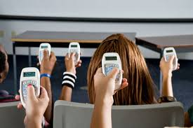
Teachers’ Wish List
  Workshops
    Beginner and advanced level workshops
    At convenient times for teachers
    “How To” video clips posted online
  Clickers / polling programs
  Smartboard
  Apple computers
  Specific software
Notes:
LK Après avoir énuméré certains exemples, mentionner que tout n’était pas négatif dans les commentaires des profs. Ils mentionnaient aussi qu’ils arrivaient à régler les problems, que ce soir avec l’aide de leurs collègues, en participant à une formation ou en trouvantune alternative plus efficace. 1 = techniques, 2 = institutionnels, 3 = étudiants

Slide 28
Phase Three: Comparison of the Student and Teacher Perspectives
Notes:
MJ

Slide 29
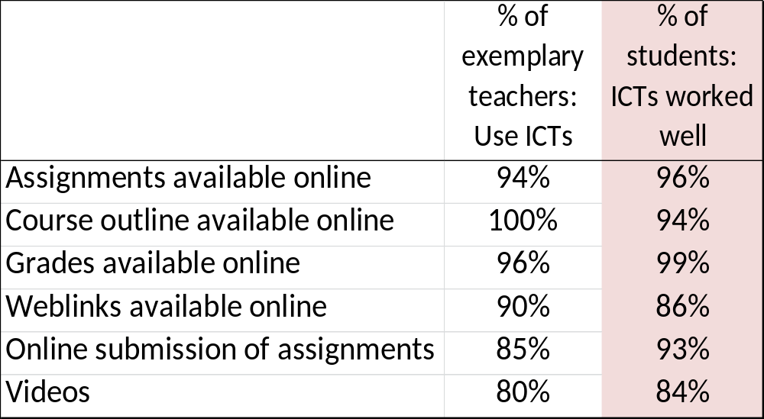
Students and Professors Agree
Notes:
MJ

Slide 30
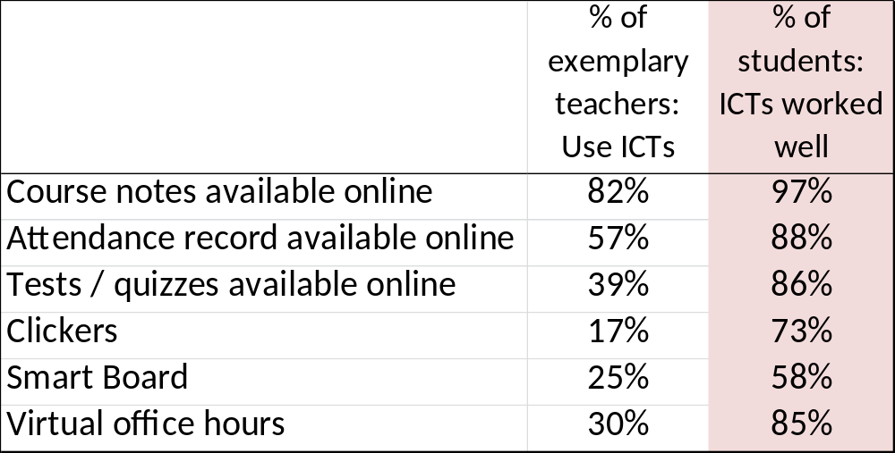
Students and Professors Disagree
Notes:
MJ

Slide 31
Comparison of Student and Faculty Views About Use of Personal Technology in Class
Notes:
MJ Similaire entre étudiants et profs exemplaires MAIS grosses différences lorsqu’on étend la population à tous les profs (voir diapo suivante)

Slide 32
Innovative technology used by teachers
Notes:
LK

Slide 33
List of Technology
Use of cell phones to create paper negative portraits to simulate the experience of photography of the 1880s
Wacom Tablet
Ozobot
Swivl
ARDUINO boards
BeeWorks
Notes:
LK

Slide 34
Do’s and don’ts of research (tips and advice from researchers with over 20 years of experience)
Notes:
LK

Slide 35
Best Research Practices
Gender as a variable
Open-ended questions
Complementary skills
Mutual respect and a common goal
Communication strategies
Knowledge + mentoring
Appreciation for contributions
Invite a cross-section of stakeholders
Notes:
LK

Slide 36

Questions?
Notes:
LK

Slide 37
Contact Us
Laura King
laura.king@claurendeau.qc.ca
Mary Jorgensen
mjorgensen@dawsoncollege.qc.ca
Catherine Fichten
catherine.fichten@mcgill.ca
Notes:
LK

