Slide 1

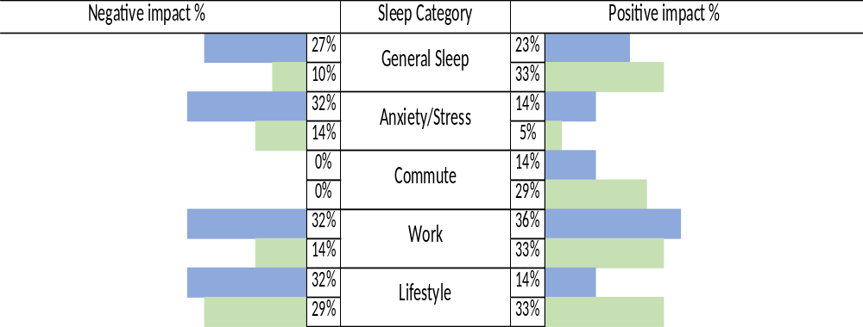
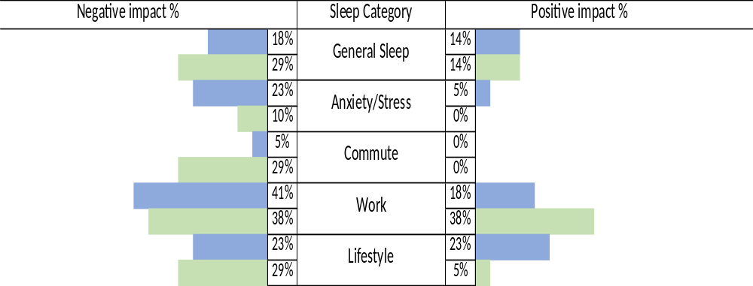

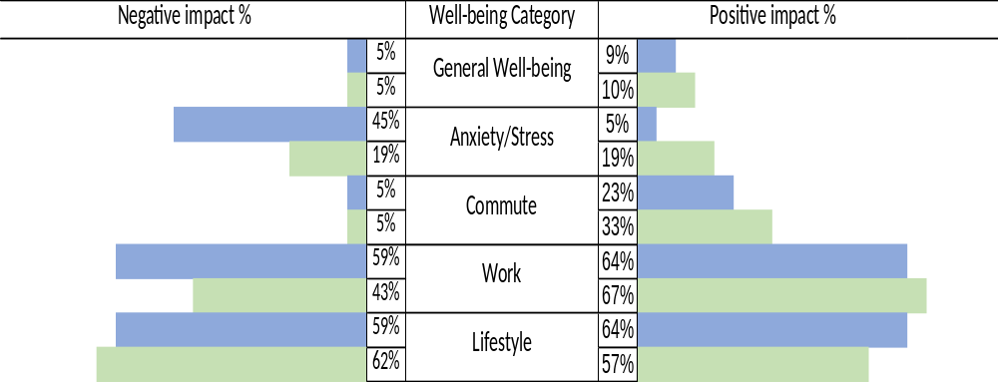
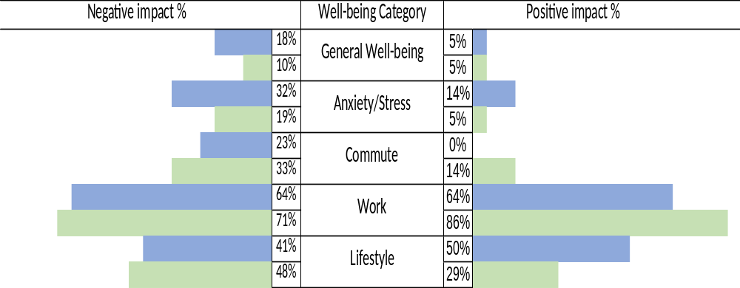

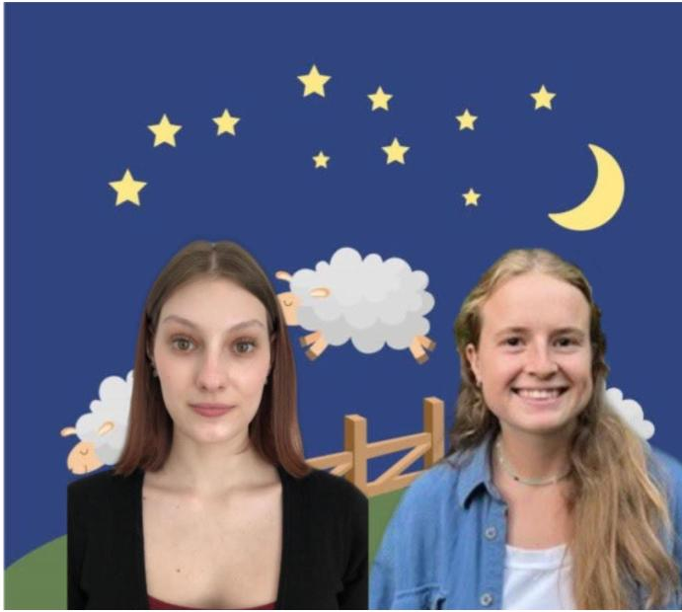






Title
Sleep and well-being during the recent online activities and during the return to face-to-face activities: faculty and non-teaching staff
Samantha Wing^{1,2}, Georgiana Costin^{1,2}, Alice Havel^{1,3}, Susie Wileman^{1,3}, Mary Jorgensen¹, Maegan Harvison¹, Abi Vasseur^{1,3}, Daniel Ereshchenko^{1,3}, Gilda Boffa⁵, Christine Vo¹, Laura Creti^{2,4}, Sally Bailes^{2,4}, Eva Libman^{2,4}, Catherine Fichten^{1,2,3,4}
                ¹Adaptech Research Network ²McGill University ³Dawson College ⁴Jewish General Hospital ⁵Association québécoise pour l'équité et l'inclusion au postsecondaire
Presentation at the Cognitive Science Research Day, McGill University
April 13th, 2023
The goal was to examine the sleep experiences and well-being of faculty and non-teaching staff at Dawson College during the recent COVID-19 remote working period as well as during the return to in-person work.
Highlighted positive and negative outcomes of each period.
Participants (1 English college)
4 focus groups + 20 Interviews
  Faculty (n = 22)
  Non-teaching staff (n = 21)
  Measures
Focus group/interview questions:
What were positive and negative factors that affected your sleep and well-being during the remote teaching/working period?
What were positive and negative factors that affected your sleep and well-being during the return to in-person teaching/working?
Is there anything else you would like to tell us about your sleep?
Analysis
Group thematic coding
Sleep categories
Well-being categories
Goal of Study
Results
  Items
    Items
      Items
        Items
Sleep Experiences during Remote
Sleep Experiences during the Return to In-person
Methodology
Well-being during Remote
Well-being during the Return to In-person
More participants commented on their well-being than their sleep.
Faculty experienced slightly more negative sleep and well-being outcomes during the COVID-19 remote period.
Overall, the highest number of participants commented on positive well-being impacts regarding work during the return to in-person.
However, both faculty and staff commented more on negative outcomes on sleep and well-being during the return to in-person teaching/working.
Take-Home Messages
There were positive and negative impacts on sleep and well-being during both time periods.
Sleep and well-being outcomes were slightly better during the remote period, especially for staff members.
The return to in-person seemed to contribute to significantly more negative sleep and well-being outcomes for both faculty and staff.
samantha.wing@mail.mcgill.ca

