Slide 1



Sleep, Insomnia, Ghoulies and Ghosties, and Things that Go Bump in the Night
Catherine Fichten
Dawson College Social Science Week, February, 8, 2023
Montreal
  catherine.fichten@mcgill.ca
Notes:
Scottish Prayer:
From ghoulies and ghosties
And long-leggedy beasties
And things that go bump in the night,
Good Lord, deliver us!

Slide 2
Learning Objectives
Understanding
  Sleep
  Insomnia
  Delayed/advanced sleep phase
  Nightmares
Understanding parasomnias
  Sleepwalking
  Sleep paralysis
  Night terrors
  catherine.fichten@mcgill.ca

Slide 3
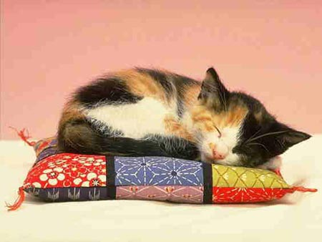
(kitten)
  catherine.fichten@mcgill.ca
Notes:
3

Slide 4
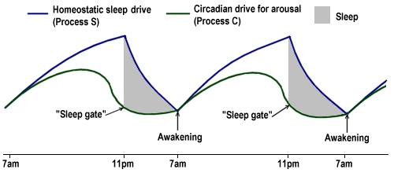
Understanding Sleep
Regulated by 2 opposing systems
      Homeostasis (sleep drive)
          Longer time since sleep, the sleepier
    Circadian rhythm (alerting force)
      Daily behavioral and physiological cycle
      Independent of preceding sleep or wakefulness
  Coordinated with day-night / light-dark
  Melatonin, cortisol, temperature
  catherine.fichten@mcgill.ca
Notes:
4

Slide 5
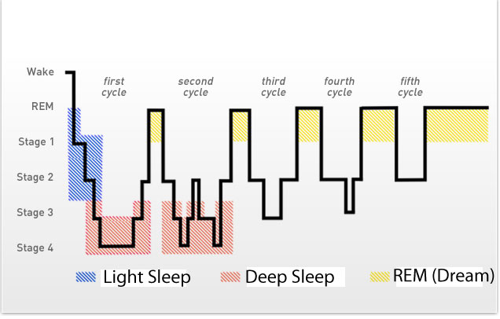
Sleep Phases
  catherine.fichten@mcgill.ca

Slide 6
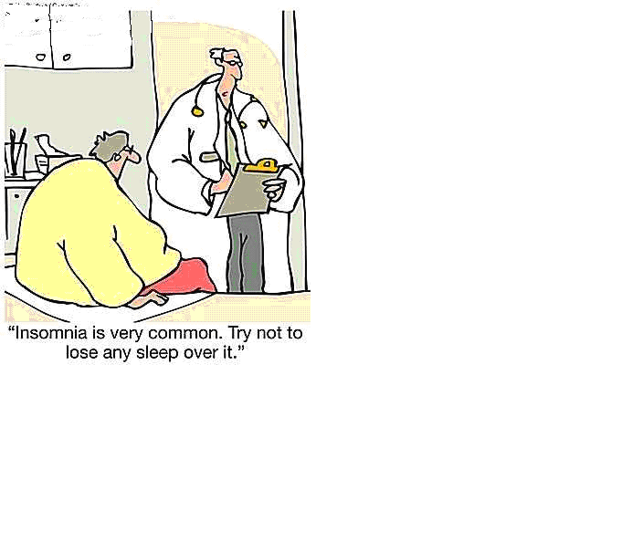
Understanding Insomnia
  catherine.fichten@mcgill.ca

Slide 7

Understanding Insomnia
Definition
  At least 31 minutes unwanted wakefulness
  At least 3 times per week
  At least 3 months
    Difficulty falling asleep (SOL)
    Difficulty staying asleep (WASO)
    Terminal insomnia
    Broken or irregular sleep
  Daytime consequences / distress
  catherine.fichten@mcgill.ca

Slide 8
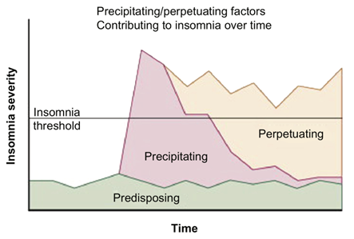
Understanding Insomnia
Causes
  Predisposing factors
    Heredity
    Cognitive or physiological hyperarousal
  Precipitating factors
    Triggers – the “cause” of insomnia
  Perpetuating factors
    E.g., longer bedtimes, naps
  catherine.fichten@mcgill.ca

Slide 9
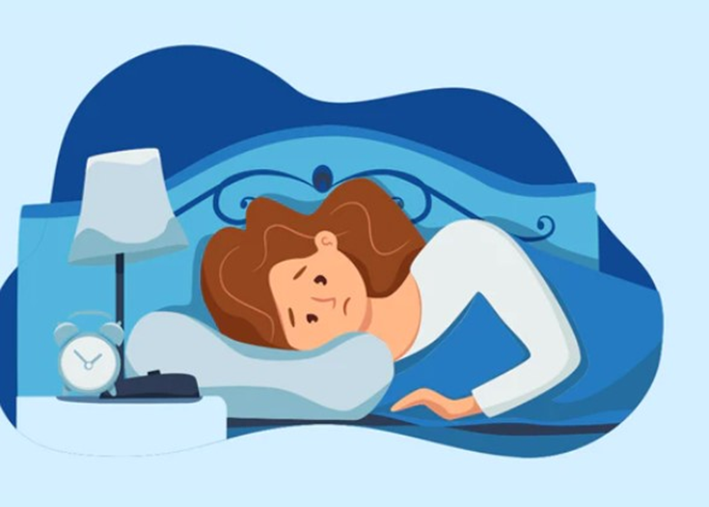
Sleep Onset Insomnia
Try the following
  Set aside “worry time”
  Maintain a “buffer period”
  Move bedtime later, keep arising constant
  Interrupt intrusive thoughts in bed
    Read, listen to verbal material, TV
  Learn to rest
    Relaxation, guided imagery
  catherine.fichten@mcgill.ca

Slide 10
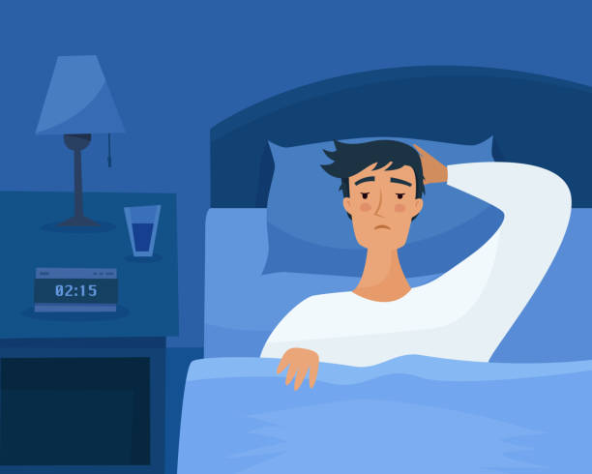
Sleep Maintenance Insomnia
Wake after sleep onset + difficulty getting back to sleep
Try
  Move arising time earlier, bedtime constant
  If awake and agitated in bed, get out of bed
    Go back to bed ONLY when sleepy
  If comfortable in bed
    Relaxation exercises, imagery, reading, TV
  catherine.fichten@mcgill.ca

Slide 11
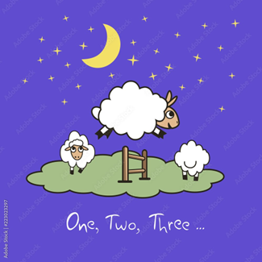
For Broken or Irregular Sleep
  Sleep restriction
    Establish average nightly SLEEP time (e.g., 6 hr.)
    Choose consistent bedtime and arising time to yield EXACTLY this amount in bed (e.g., 6 hr.)
      Never less than 5 hr.
    Alter both bedtime and rising time
    When sleeping the allotted time for 1 week
      Add 15 min. to bedtime and repeat
  Avoid napping
  catherine.fichten@mcgill.ca
Notes:
11

Slide 12
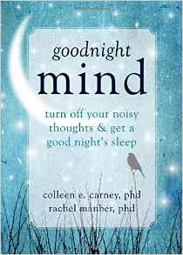
For Longstanding Insomnia
A psychologist
Bibliotherapy
  “Goodnight mind”
Online
  Sleepio
  Go! To Sleep Program – Cleveland
  SHUTi
  catherine.fichten@mcgill.ca

Slide 13

Owls and Larks
Morningness Eveningness Questionnaire
Large hereditary component
Larks
  Up-at-dawn
  Raring-to-go early bird
Owls
  Enjoy staying up late
  Trouble waking up in the morning
  catherine.fichten@mcgill.ca

Slide 14
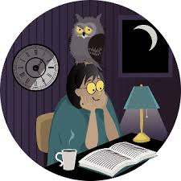
Owls and Larks
Readings
  “Gender differences in morningness-eveningness preference”
  “Can night owls become early birds?”
https://www.ncbi.nlm.nih.gov/pubmed/12182498
https://www.theglobeandmail.com/life/can-night-owls-become-early-birds/article26113963/
  catherine.fichten@mcgill.ca

Slide 15
Delayed or Advanced Sleep Phase
Problem
  Falling asleep
    Very late = delayed sleep phase (students, ADHD, autism)
    Very early = advanced sleep phase (older adults)
  Waking late (or early) – 7-8 hours later
This is NOT insomnia
  Reading
    “Delayed Sleep Phase Syndrome - Cleveland Clinic”
https://my.clevelandclinic.org/health/diseases/14295-delayed-sleep-phase-syndrome-dsps
  catherine.fichten@mcgill.ca

Slide 16
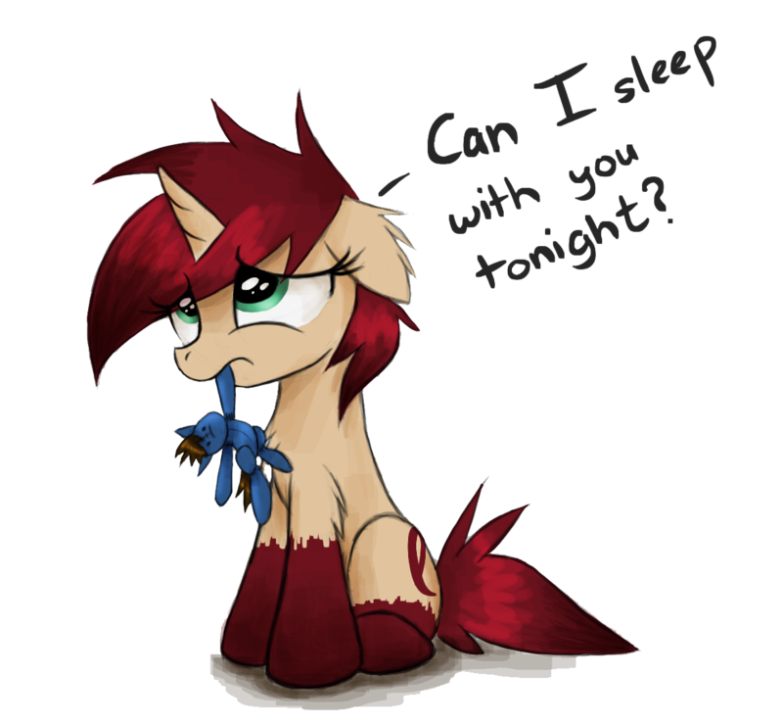
Nightmares: Imagery Rehearsal Therapy
Barry Krakow
  Choose a recent nightmare
    Unrelated to a real life traumatic event
  Replay nightmare but change story & ending
  In thoughts or in writing
Rehearse the revised dream
  Re-write it or play again in your mind
  5 to 10 minutes before bedtime
Reading
    “Transform Nightmares into Sweet Dreams: Bottom Line”
https://bottomlineinc.com/health/sleep/transform-nightmares-sweet-dreams
  catherine.fichten@mcgill.ca

Slide 17

Chronic Nightmares Video
  catherine.fichten@mcgill.ca

Slide 18
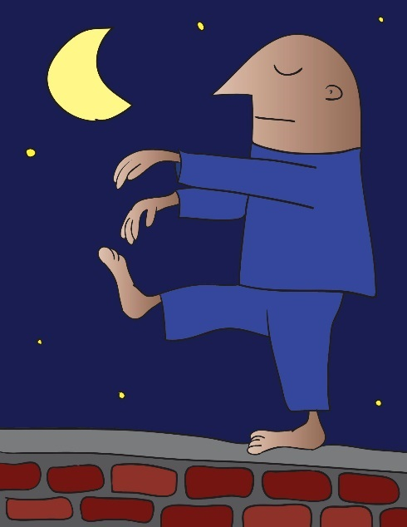
Understanding Parasomnias
  Sleepwalking
    Occurs in deep sleep
    Not just walking
      Complex behaviors
    Not associated with dreams
    Can be dangerous NOT to wake person
    Reading
      “National Sleep Foundation – Sleepwalking” https://sleepfoundation.org/sleep-disorders-problems/abnormal-sleep-behaviors/sleepwalking
  catherine.fichten@mcgill.ca

Slide 19
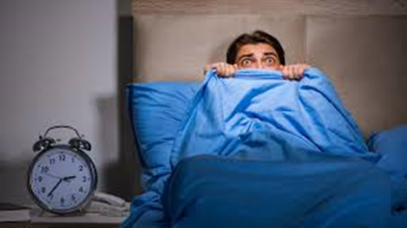
Understanding Parasomnias
  Night terrors
    Episodes of screaming, intense arousal flailing while still asleep
    Terrifying for observer
    Generally not remembered by sleeper
    Hard to wake the sleeper
  Reading
    “Sleep terrors (night terrors) – Mayo Clinic”
https://www.mayoclinic.org/diseases-conditions/sleep-terrors/symptoms-causes/syc-20353524

Slide 20
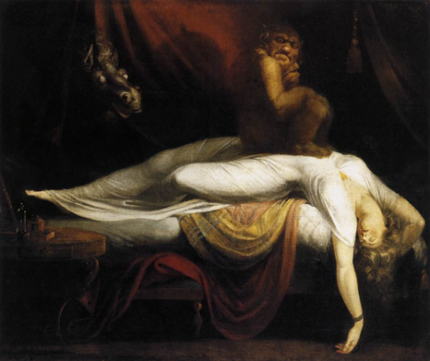
Understanding Parasomnias
Sleep paralysis +
  Hypnagogic hallucination – when falling asleep
  Hypnopompic hallucination - when waking up
    Waking & conscious but unable to move
    Feeling of choking or pressure on chest
    Incubus / succubus attack
    Lasts minutes
    Reading
      “Sleep Paralysis – WebMD”
      https://www.webmd.com/sleep-disorders/guide/sleep-paralysis#1
  catherine.fichten@mcgill.ca

Slide 21

Questions
We are doing research on sleep patterns and experiences. For more info or if you are interested
Email catherine.fichten@mcgill.ca
Dr. Catherine Fichten
Psychology Department
Dawson College

