Slide 1



10 EASY Things You Can Do to Make Your Course More Accessible to Students With Disabilities
Alice Havel, Catherine Fichten, Mary Jorgensen,
Adaptech Research Network
Intercollegiate Ped Days
January 12th, 2022

Slide 2

Who Are We?
The Adaptech Research Network is
  Team of teachers, professionals, students, researchers
  Conduct research on post-secondary students with and without disabilities
  Focus on technologies
  Based at Dawson College

Slide 3

Who Are You?
  Teacher
  Access service provider
  Administrator
  Pedagogical Counsellor
  Other

Slide 4

From Which College?
Champlain
Dawson
Heritage
John Abbott
Marianopolis
Vanier
Other

Slide 5

What Motivated You To Register?
Please put your response in the chat

Slide 6

Our Goals For the Session
Share things that can help make a course accessible
Provide instructions on how to do these things
Encourage you to exchange information

Slide 7

Sources of Our Information
Research findings – ours and other researchers’
Questionnaires, focus groups, and interviews
  Students
  Faculty
  Professionals
E-Access Concordia Project
COVID-19 practices

Slide 8
Who Are the Students In Our Research?
15 to 20% of students self-reported a disability
50% had multiple disabilities
50% were not registered with accessibility services
Two most frequent disabilities reported
  Mental health issues
  Learning disabilities (LD) / attention deficit hyperactivity disorder (ADHD)

Slide 9
Thing # 1: Communicate Constructively
Invite students to indicate accessibility needs
  In class
  On course outline
Use only one learning management system
  E.g., Lea, Moodle
Use multiple formats to convey ideas
  E.g., text, audio, video, diagrams
Repeat students’ questions

Slide 10
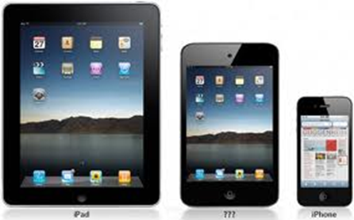
Thing # 2: Allow Use of Personal Tech In Class
Students like to use their personal tech in class
  Set clear guidelines
Students need personal tech to
  Take class notes
  Read instructions or textbook
  Take photos of board or screen
  Organize self
  Get help

Slide 11
Thing # 3: Use Tech in Teaching
Use technology
  That has a purpose
  Functions well
Students like
  Online posting of PowerPoints, readings, grades, videos of lectures
  Polling, online quizzes, PPT fill in the blank
  Online assignment submission

Slide 12
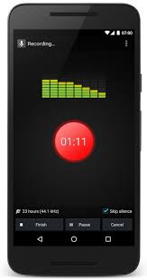
Thing # 4: Support Students in Use of Tech
Provide instructions on how to
  Navigate course management system
  Use required software
Encourage use of assistive technology
  Built into general use technology
    Dictation in Microsoft 365
    Narration (text-to-speech)
  Apps to help with
    Reading
    Writing
    Time management

Slide 13

Thing # 5: Make Sure Formats Are Accessible (1)
Cannot assume that digital = accessible
Why format is important
  To access screen readers, text-to-speech, apps
  To change font, text size, spacing, colour
  To add notations

Slide 14
Thing # 5: Make Sure Formats Are Accessible (2)
Types of files that are generally accessible
  PowerPoint
  Word
  EPUB
    Most accessible for textbooks
If you want to convert a Word or PPT document to PDF
    SAVE to PDF
    Do not PRINT to PDF

Slide 15
Thing # 5: Make Sure Formats Are Accessible (3)
Excel not always accessible
  Add alt text to table or graph
  Label all cells in first row and column
Row 1 | Name | Phone number | Email
Row 2 | Jane Doe | 555-123-4567 | Jane.Doe@gmail.com
Row 3 | John Smith | 555-456-7123 | John.Smith@outlook.com

Slide 16
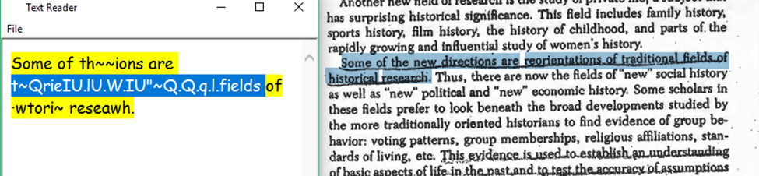
Thing # 5: Make Sure Formats Are Accessible (4)
Make course packs accessible
  No underlining or handwriting
  No shaded background
  No missing or light text
  No content cut off at edges
  No partial pages visible on side
https://www.uvic.ca/services/cal/courses/course-materials/coursespaces-material/index.php

Slide 17
Thing # 6: Make PowerPoints Accessible
Use sans serif font, such as Arial or Calibri
Use minimum 24 pt. font
Use high contrast between text and background
Avoid distracting background images

Slide 18
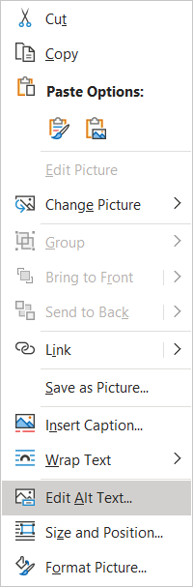
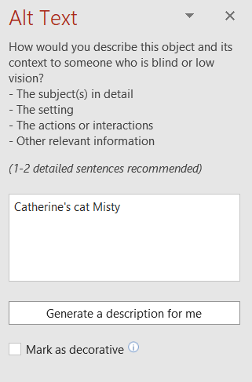
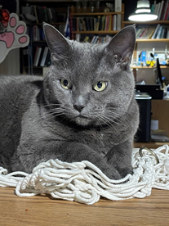
Thing # 7: Provide Alt Text
Add alt text to all images, graphs, and tables
  Word
  PowerPoint
  Excel

Slide 19
Thing # 8: Caption Videos (1)
Convert audio content into subtitles
  Automatic captions generated by AI
    Available on Zoom and Teams
    Can be turned on and off
    May require editing (craptions)
      Unedited captions are better than nothing

Slide 20
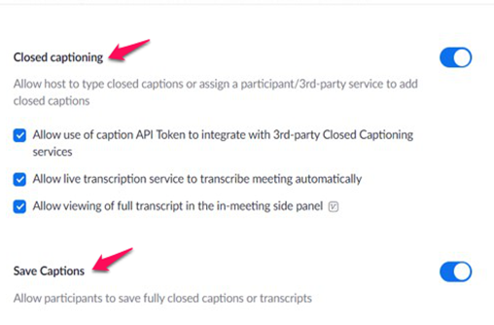
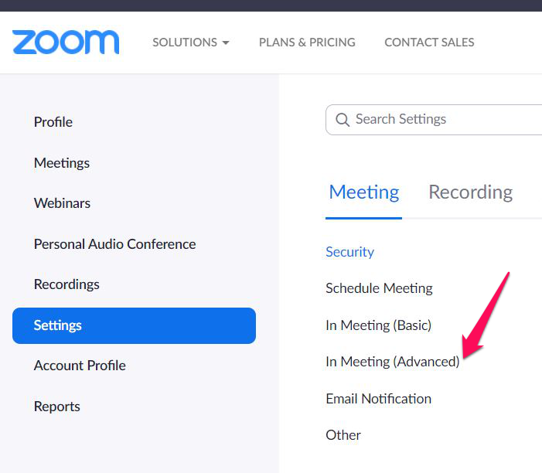
Thing # 8: Caption Videos (2)
Create Zoom Automatic Captions
Log into your Zoom account

Slide 21

Thing # 9: Prepare Accessible Assignments & Evaluations (1)
  For assignments
    Allow for flexibility in the due dates (slip day)
  For tests and exams
    Allow all students extended time on tests
      Unless speed is an essential competency
    Option to justify answers
      E.g., for multiple choice/true-and-false questions

Slide 22
Thing # 9: Prepare Accessible Assignments & Evaluations (2)
To allow a student extended time on a Moodle quiz
  Click the Gear icon
  Choose “User overrides”
  Click “Add user override”
  Click the down arrow to scroll to the appropriate student

Slide 23
Thing # 10: Be Aware of Mental Health Issues
44% of students reported feeling depressed ¹
Provide flexibility around deadlines
Offer alternatives to oral presentations
Don’t make all students talk in class
Distinguish roles of teacher and therapist
¹https://bp-net.ca/wp-content/uploads/2019/04/2018_Breaking-Down-Barriers-Mental-Health-and-Canadian-Post-Secondary-Students_CASA.pdf

Slide 24
What Do You Think?
We want to hear your:
(1) Opinions
(2) Experiences
(3) Questions

Slide 25

Resources
MOOC: Basics of Inclusive Design for Online Education https://www.coursera.org/learn/inclusive-design
E-Access Concordia Project https://adaptech.org/research/e-access-concordia-project/
Adaptech Research Network: www.adaptech.org
Alice Havel: ahavel@dawsoncollege.qc.ca
Catherine Fichten: catherine.fichten@mcgill.ca
Mary Jorgensen: mjorgensen@dawsoncollege.qc.ca

