Slide 1





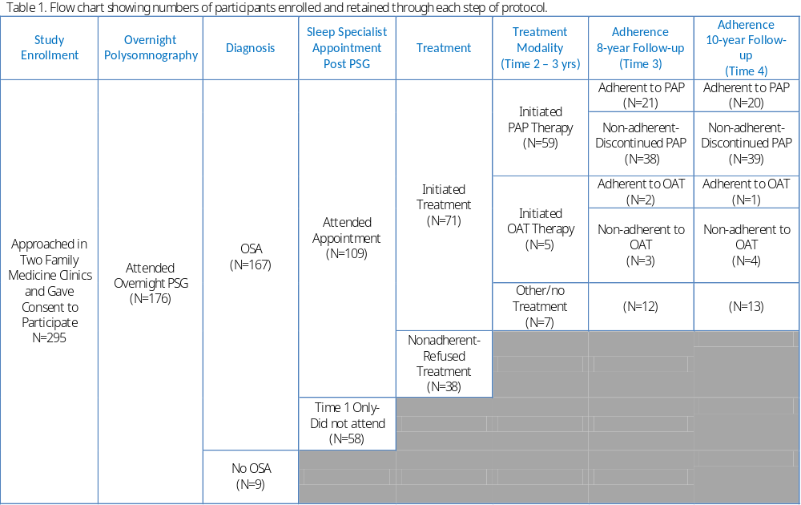


Treatment trajectory of OSA:
From doctor recommendation to treatment choice.
Nelly Huynh¹, Sally Bailes^{3,4}, Dorrie Rizzo^{3,4}, Gilles Lavigne^{1,2}, Marc Baltzan^{3,5}, Si Ming Lin¹, Eva Libman^{3,4}, Catherine Fichten^{3,4}
¹Université de Montréal, ²Hôpital du Sacré-Coeur de Montréal, ³McGill University, ⁴Jewish General Hospital, ⁵Mount-Sinai Hospital
Introduction
Measures & Procedures
Results
Obstructive sleep apnea (OSA) is a chronic condition with deleterious physical health outcomes, compromised quality of life and increased healthcare usage.
OSA is under-recognized in primary care settings.
After initial diagnosis, we know little about the long-term trajectory of OSA and treatment usage.
The objective of the present study was to assess the 10-year prospective trajectory of OSA treatment in middle- to older-aged patients followed in a primary public healthcare setting. An additional goal was to test whether providing information about oral appliance therapy (OAT) and positive airway pressure (PAP) therapy would increase treatment uptake and adherence.
TIME 1 – Initial Diagnosis Visit
Participants were approached at their doctor’s office and asked to participate in a sleep study, regardless of sleep-related complaints. They all underwent in-laboratory polysomnography (PSG) and completed questionnaires in 2012-2013 (Time 1).
Participants receiving a diagnosis of OSA were followed for recommended treatment according to usual medical practice, either PAP or OAT, if indicated.
TIMES 2 TO 4 – Follow-up Visits
Participants were re-contacted at three time points post-diagnosis: 3 years (Time 2), 8 years (Time 3), and 10 years (Time 4).
At each time point, participants were administered the home sleep apnea testing (HSAT) and questionnaires. They were questioned regarding initiation and adherence to OSA treatment, type of treatment (e.g., PAP, OAT, or change of treatment status (e.g., discontinuation, start of therapy).
At Time 3 (8 years), participants with OSA were provided more information about the two main treatment options (i.e. OAT, PAP) which included more recent knowledge about long term benefits of both approaches. At Time 4, participants were asked about whether they had tried or had considered trying either PAP or OAT therapy.
Of 176 participants who underwent PSG, 92.6% (167) received a diagnosis of OSA (Time 1).
At Time 2, only 32.5% of diagnose participants-initiated treatment: 46 PAP (mean AHI=36.8, SD=25.3), 5 OAT (mean AHI=21.2, SD=4.2), and 2 weight loss & gastric bypass. Of those who initiated PAP, 64% (38/59) discontinued treatment by Time 3, while for OAT, 60% (3/5) discontinued treatment (Table 1).
Before the Time 3 intervention, 26% of participants reported knowing about OAT as a treatment option for OSA, as opposed to 70% at Time 4. At Times 3 and 4, rates of adherence remained stable for both PAP and OAT.
Although, over time, more explanation was provided on efficacy of both treatments, no changes occurred in already treated patients and no additional treatment uptake was noted among the 67.5% of individuals who initially declined OSA treatment.
Participants
Conclusions
Acknowledgements
Consecutive primary care adults who had been diagnosed with OSA 10 years previously:
167 participants with OSA :
  95 women
  72 men;
  mean age=56.6, SD=10.7
The high prevalence of OSA in our primary care sample reflects the importance of screening for OSA when suspected at primary care appointments. However, low rate of treatment initiation in a primary care setting should also be further investigated in terms of cost, patient lack of knowledge regarding OSA risk, low motivation, inadequate primary caregiver communication, etc. In addition, our data raises the question of whether treatment adherence would have improved had patients received a clear treatment choice earlier in the diagnosis-treatment sequence, with enhanced information about the OAT option.
We thank the American Academy of Dental Sleep Medicine and the Canadian Institutes of Health Research for funding this project.

